Slide 1
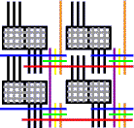
Hardware Accelerated FPGA Divide-and-Conquer Page Placement in Milliseconds
Ezra Thomas, Dr. Jing Li, Dr. André DeHon
Implementation of Computation Group
University of Pennsylvania
Notes:
Hello my name is Ezra Thomas and today I am presenting my research with Professor Li and Professor DeHon entitled Hardware Accelerated FPGA Divide-and-Conquer Page Placement in Milliseconds

Slide 2
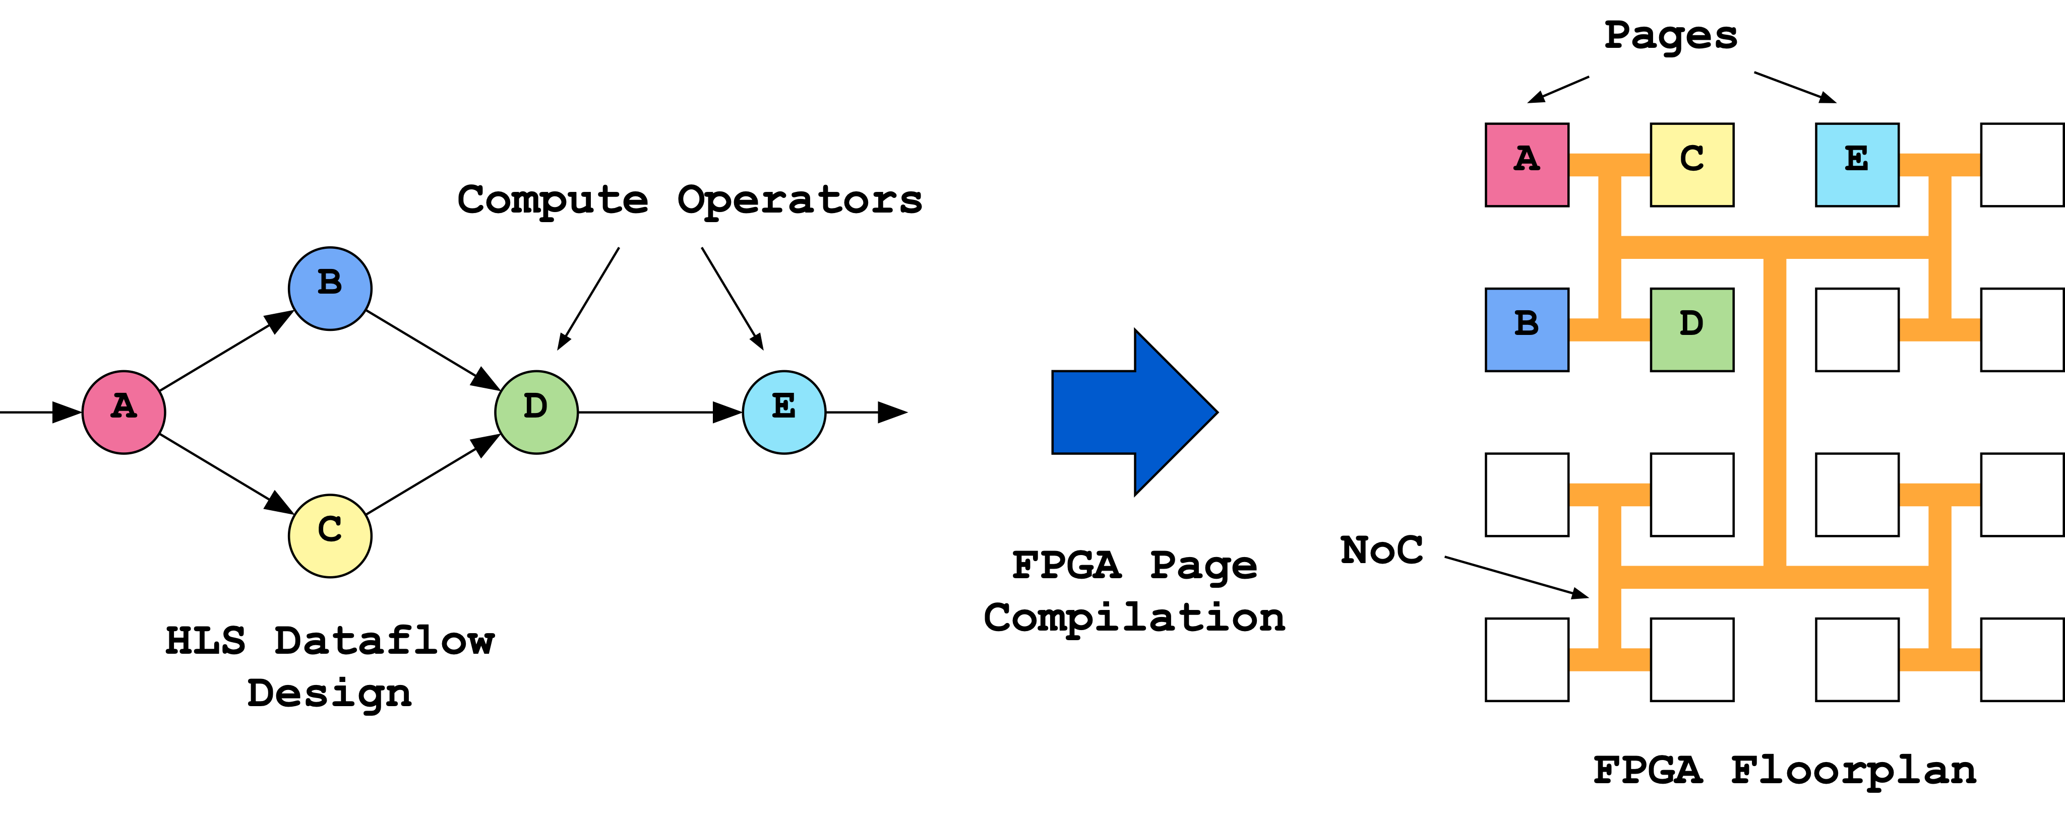
Story
FPGA compilation is excruciatingly slow (up to hours long runtime)
  Limits developer productivity
  Prevents use in real-time reconfiguration applications like online-tuning and self-healing
  Placement and routing most expensive phases of compilation
Separate page-based compilation achieves acceleration through
divide-and-conquer (e.g. PR-Flow)
  Brings compile times down to 10s of seconds to minutes (but too slow for real-time applications)
Notes:
As we all know, FPGA compilation is excruciatingly slow, often taking hours, with placement and routing forming the bottleneck. These long runtimes severely limit developer productivity and hinder the implementation of applications which require real-time reconfiguration, such as online-tuning and self-healing. [click]
Divide-and-conquer techniques such as PR-Flow accelerate compilation by decomposing a large dataflow application into distinct compute operators, and then separately compiling each operator in parallel, mapping them onto unique regions or pages of the target FPGA, which are all linked together by a network on chip. This can bring compilation down to minutes or even 10s of seconds, but is still too slow for applications which require real-time reconfiguration.

Slide 3
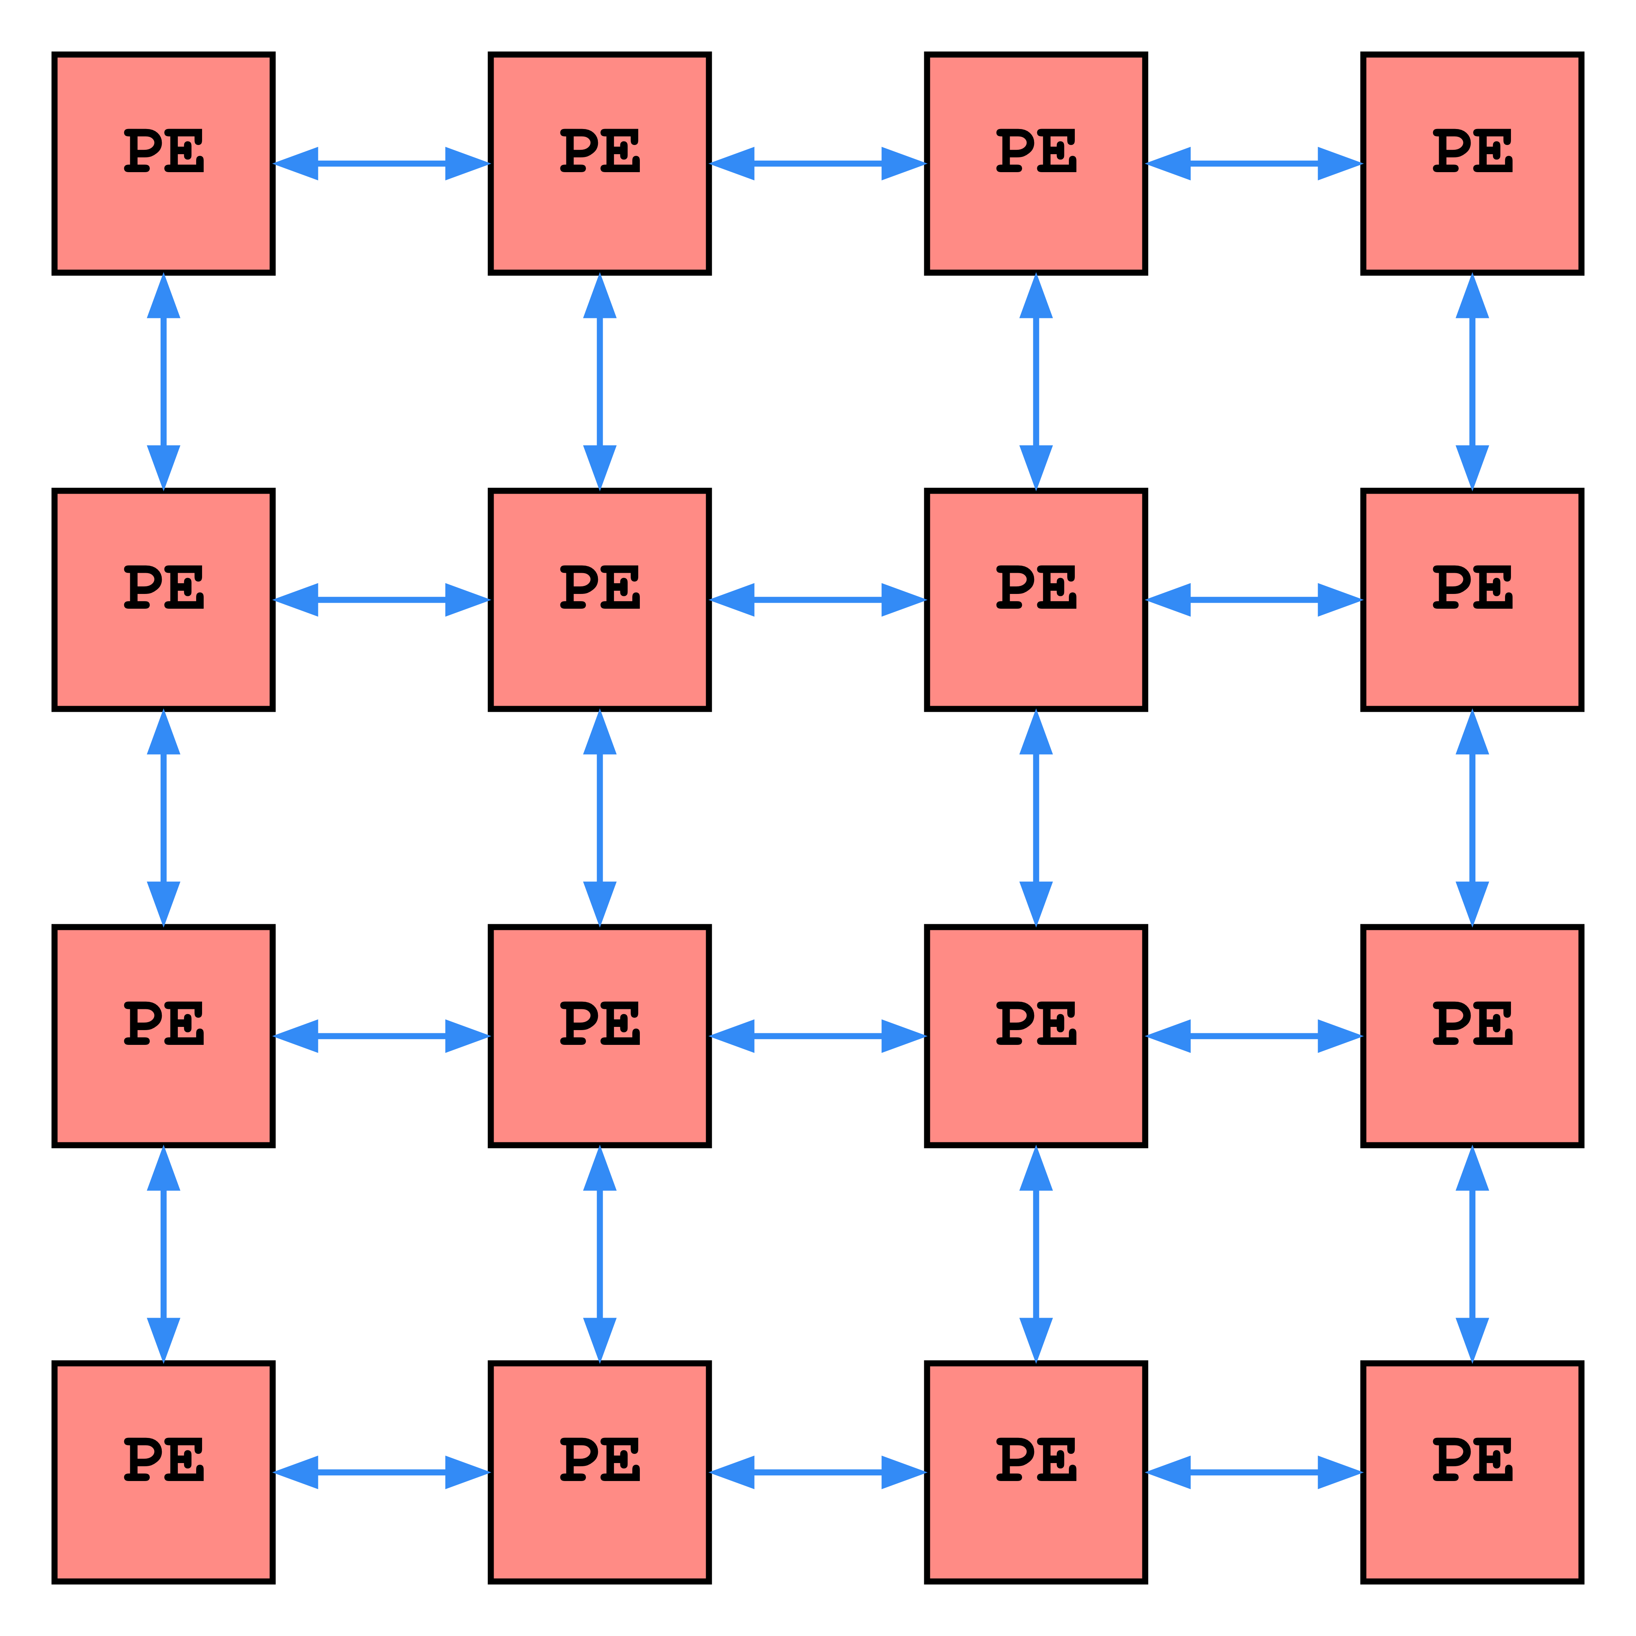
Story
FPGA compilation is excruciatingly slow (up to hours long runtime)
  Limits developer productivity
  Prevents use in real-time reconfiguration applications like online-tuning and self-healing
  Placement and routing most expensive phases of compilation
Separate page-based compilation achieves acceleration through
divide-and-conquer (e.g. PR-Flow)
  Brings compile times down to 10s of seconds to minutes (but too slow for real-time applications)
Using FPGAs themselves to perform page compilation enables significant acceleration
  We present an FPGA based systolic array which solves FPGA page placement in milliseconds
  Targets VTR-9 device models
  Achieves 2-3 orders of magnitude speedup over iso-quality VTR-9 results
Notes:
However, our thesis is that we can use FPGAs themselves to perform page compilation in order to enable real-time reconfiguration. In our paper we present an FPGA based systolic array which solves the FPGA placement problem for a page, in milliseconds.
We target VTR-9 device models, and achieve 2-3 orders of magnitude speedup over iso-quality VTR results.

Slide 4
Table of Contents
Motivation
Background
Our Accelerator
Evaluation
Conclusion
Notes:
In the rest of this talk we will first motivate why we are looking to accelerate FPGA placement and then cover some background on the placement problem and prior work on hardware acceleration. Next we will get into the details of our accelerator, and then cover its performance evaluation. Finally, we’ll wrap up with a conclusion.

Slide 5
Table of Contents
Motivation
Background
Our Accelerator
Evaluation
Conclusion
Notes:
Motivation

Slide 6
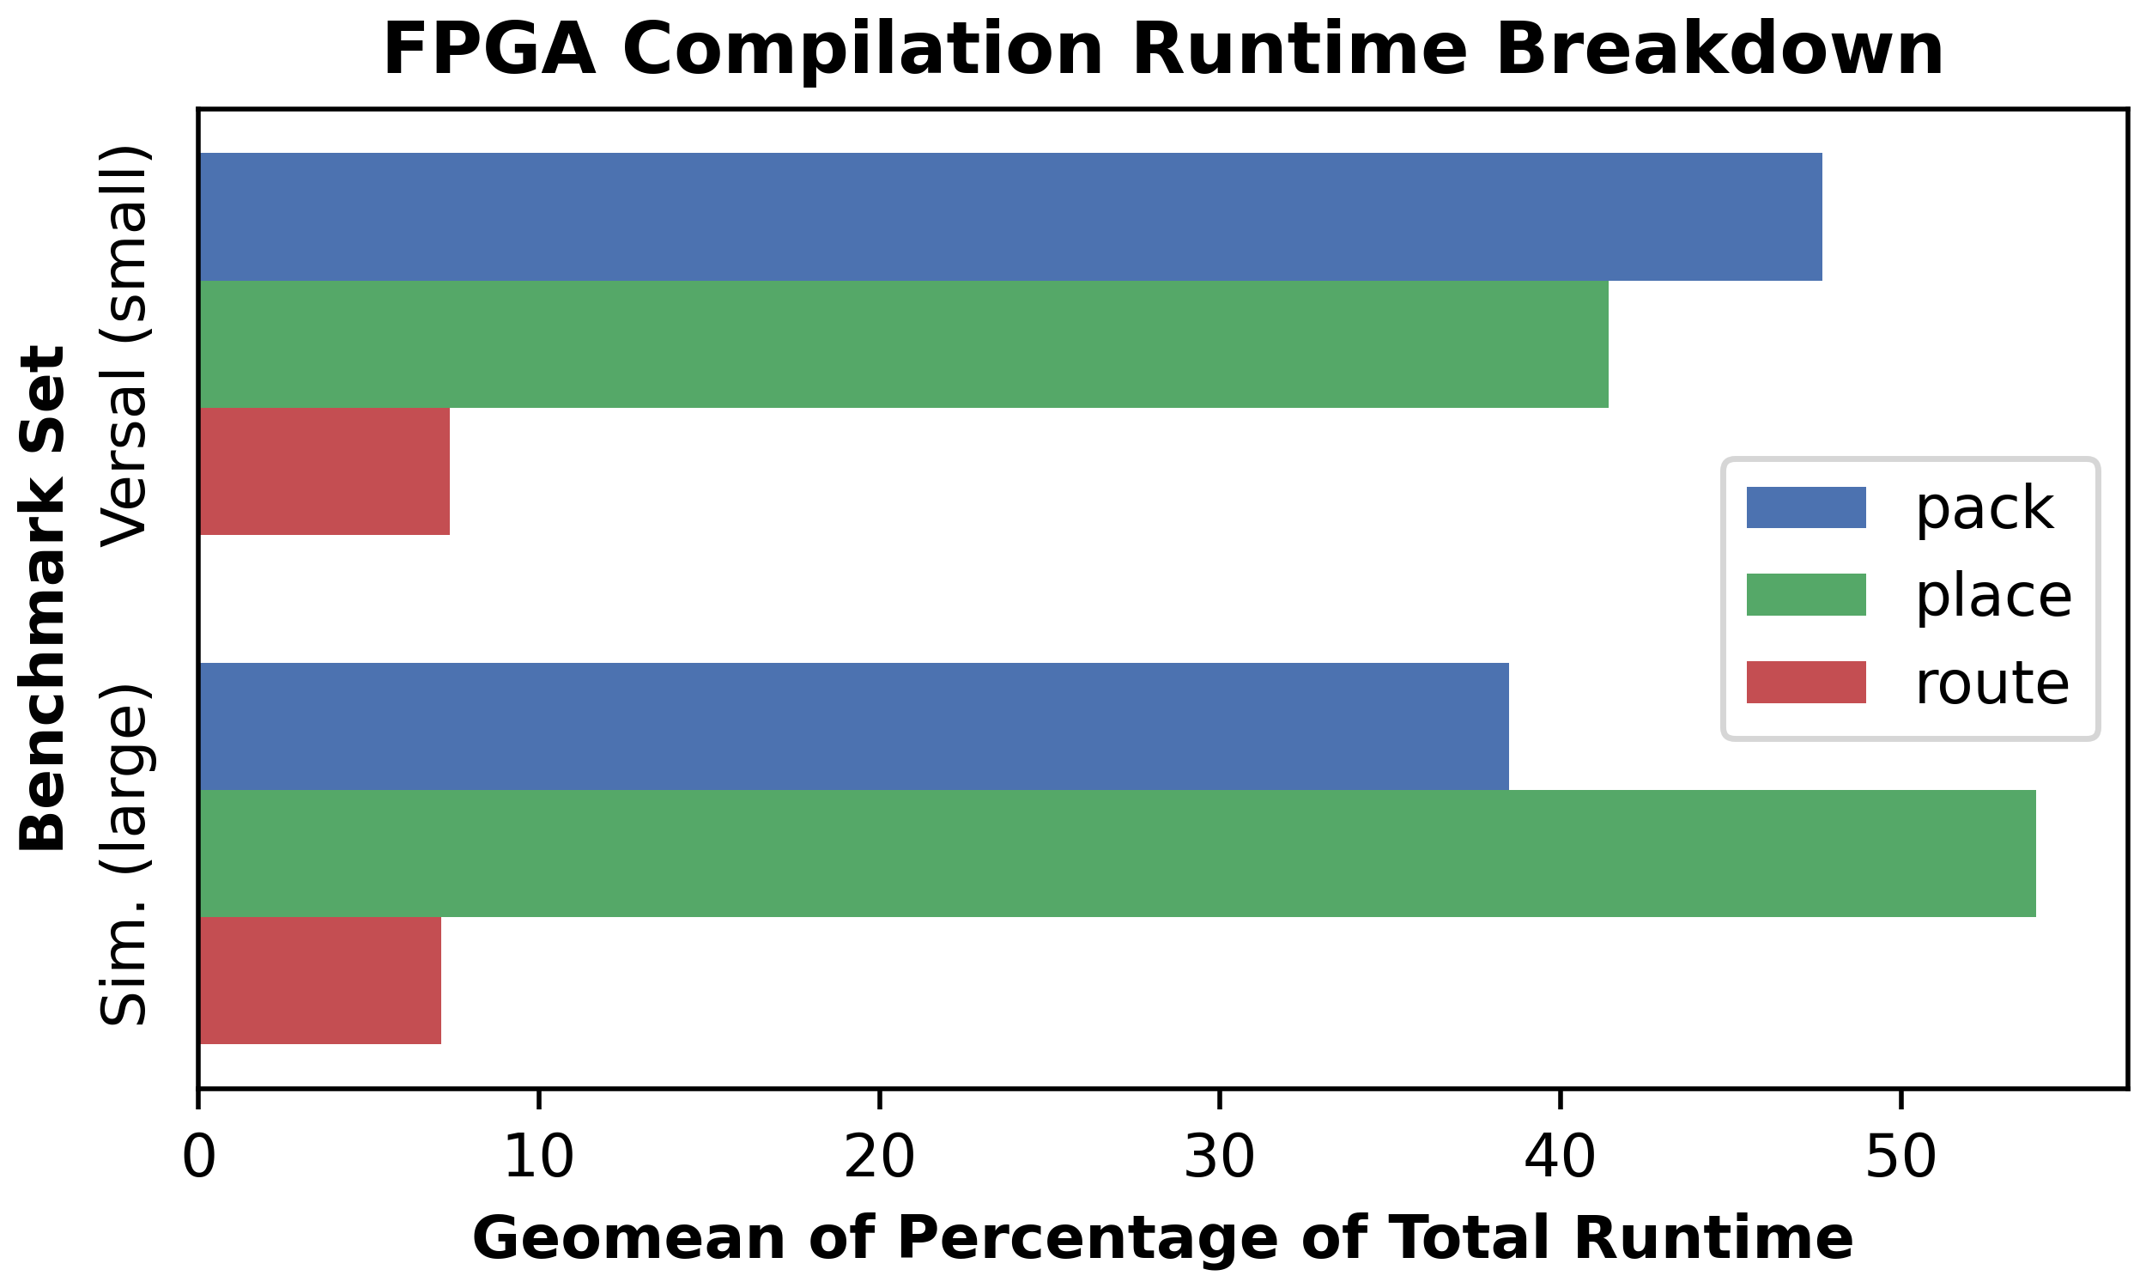
Motivation
Compilation is slow (hours)
PR-Flow page compilation is faster (minutes)
Need sub-second compilation for:
  Self-healing
  Online tuning
Compilation involves:
  Packing
  Placement
  Routing
Placement becomes bottleneck as netlist size grows
Goal: Create hardware accelerator enabling sub-second placement times
Notes:
As we mentioned before, compilation is slow, often taking hours. PR-Flow page compilation can reduce this to minutes through divide-and-conquer. But this is still too slow for applications requiring real-time reconfiguration, such as self-healing and online-tuning. [click]
FPGA compilation involves multiple implementation phases after synthesis. In VTR, these phases are Packing, which clusters LUTs into CLBs, Placement, which determines where netlist elements ought to be placed on the target FPGA fabric, and Routing, which connects all of the placed elements together with the available FPGA routing resources. [click]
This figure shows the relative runtime percentages of total compile-time for each of these compilation phases on two benchmark sets, the bottom set being much larger. This shows that in VTR, placement becomes the bottleneck as the netlist size grows. [click]
Therefore, to accelerate FPGA compilation, we devised a hardware accelerator to perform placement in milliseconds

Slide 7
Table of Contents
Motivation
Background
Our Accelerator
Evaluation
Conclusion
Notes:
Background

Slide 8
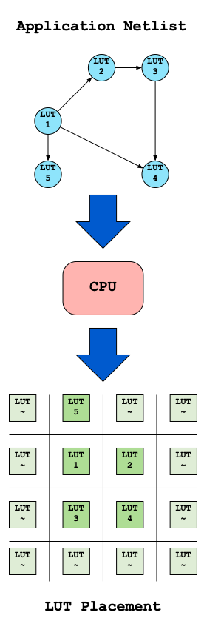
The Placement Problem
Task:
  Determine netlist element locations on target FPGA fabric
Goal:
  Minimize propagation delays between elements
  Maximize Fmax of design
Technique:
  Usually serial process performed by CPUs
  Example: Simulated Annealing
    Create cost function to measure placement quality
    Compare random pair of cells
    Swap cell positions to improve placement cost
    Sometimes take bad swaps to explore solution space
Notes:
The task of FPGA placement is to determine suitable locations on the target FPGA fabric for netlist elements of a given application [click]
The motivating goal is to minimize the propagation delay between netlist elements in order to maximize the operating frequency of the compiled application [click]
The placement solution is usually computed through a serial process performed on a CPU. One standard technique is Simulated Annealing, where, starting from an initial placement, random pairs of netlist cells are considered one at a time. The cells then swap positions if doing so would improve the placement quality. Sometimes bad swaps are taken to explore the solution space. Eventually the process converges on a high-quality placement.
Because of combinatorial explosion and the serial nature of the computation, standard placement algorithms can require significant runtime
(49s)

Slide 9
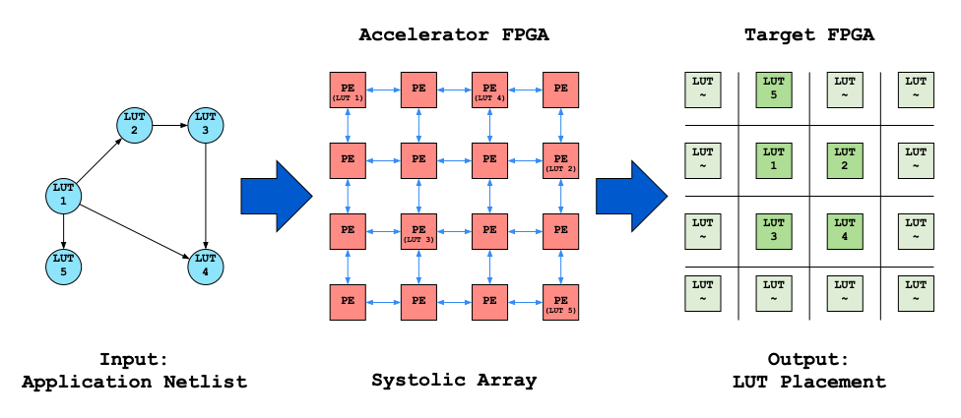
Prior Work: Systolic Placement
In 2003, Wrighton and DeHon created an FPGA based systolic array of processing elements (PEs) to perform placement
PEs swap LUTs
Swap decisions are computed locally
Swaps are performed in parallel
Produced placement results in milliseconds
Very poor scalability
Notes:
In 2003, Wrighton and DeHon sought to address slow placement times by designing a systolic array based accelerator to perform FPGA placement.
The accelerator itself was implemented on an FPGA, and would take as input an application netlist, and produce as output the final placement locations of those netlist cells on the target FPGA fabric.
Each processing element, or PE on the accelerator FPGA corresponded to a unique LUT position on the target FPGA fabric. Initially, each PE on the accelerator array was loaded with a unique LUT from the application netlist. The PEs would then exchange LUTs in parallel in order to improve the placement. Due to the massive move parallelism that this spatial solution offered, their accelerator yielded results in milliseconds, achieving orders of magnitude speedup over VPR. However, the accelerator suffered from significant scalability issues and practically, could only target tiny designs.

Slide 10
Prior Work: Local Cost Function
Goal to minimize total placement cost
But swaps are evaluated on local cost proxies:
  Does a swap reduce placement cost for pair of cells?
Idea: minimizing local costs will reduce total cost
Must periodically synchronize local cost functions with global state
Notes:
During placement, the overall goal is to minimize the total placement cost
But on the systolic array, swaps are evaluated locally, and in parallel. This means that the swaps are evaluated on a local cost proxy which asks if a swap reduces the placement cost for the pair of cells involved
The idea here is that by minimizing all of the local costs, we will reduce the total placement cost
Because swaps are happening in parallel, periodically these local cost functions must be synchronized with the global placement state, so that the swap decisions remain accurate

Slide 11
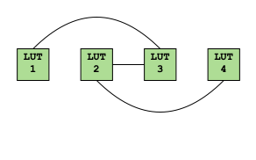
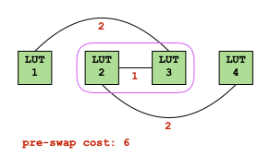
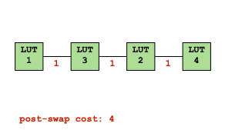
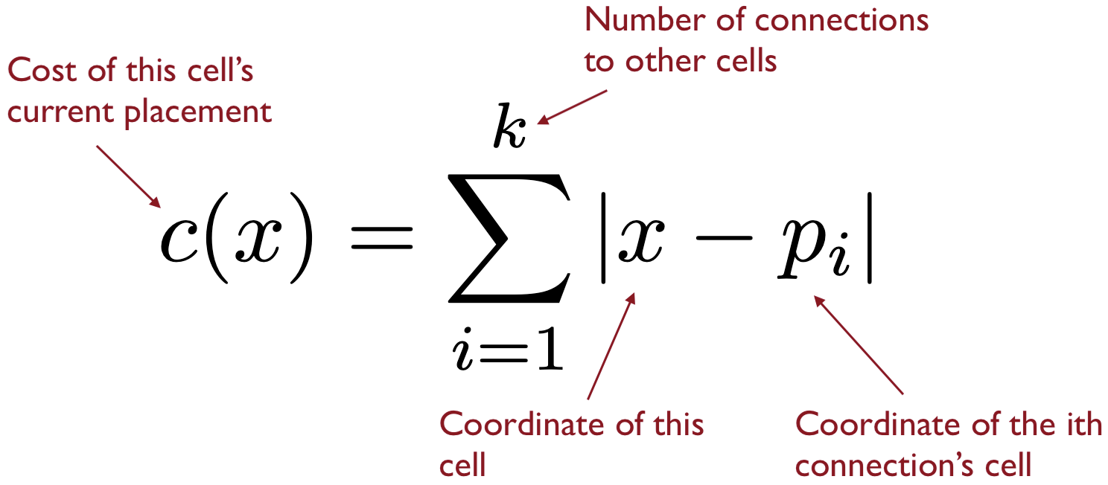
Prior Work: Local Cost Function
Measures linear Manhattan wire length between a cell and its netlist connections
Requires iteration over the cells’ lists of connection coordinates
Notes:
The local cost function used in Wrighton's work measures the linear Manhattan wire length between a cell and its netlist connections.
In this equation, x is the position of the cell we are considering, and p sub i is the position of its ith connection. To compute the placement cost for a cell, we iterate over all k of its connections.
Consider a swap between LUTs 2 and 3. [click]
Their combined costs before a swap is 6, but after a swap would only be 4, [click]
and so the swap should be taken in order to reduce the total placement cost. [click]
Again note that computing these costs requires iteration over the cell’s lists of connection coordinates

Slide 12
Prior Work: Achievements
Placed designs for VPR in milliseconds
2-3 orders of magnitude acceleration over VPR
Cost: 35% increase in min-channel width
Notes:
Wrighton and DeHon’s design was able to place netlists for VPR in milliseconds, 2-3 orders of magnitude faster than VPR at a cost of a 35% increase in the minimum channel width required to route the design. However these results were simulated, since their largest benchmark contained around 8k LUTs, but their physical systolic array could only place 56 LUTs.

Slide 13
Prior Work: Why not Adopted?
Poor build-to-place ratio:
  Each PE requires 400 accelerator LUTs
  Each PE only places one target LUT
  Severely limits target size
Accelerator only places LUTs
  CLBs, BRAMs, and DSPs have many connections
  PE swap times scale poorly with the number of connection
Notes:
Ultimately though, this systolic accelerator was not adopted into standard FPGA compilation flows, primarily for two reasons:
First, the accelerator had a poor build-to-place ratio, that is, each PE on the accelerator FPGA required 400 LUTs to implement but was only responsible for placing a single LUT on the target FPGA fabric. This poor build-to-place ratio severely limited the size of the target that could be placed, since the accelerator had to be 400 times larger. [click]
Second, Wrighton and DeHon’s accelerator could only place LUTs, and didn’t have the capacity to place heterogeneous netlists of CLBs, BRAMs, and DSPs. This limitation was primarily due to the fact that PE swap times scaled poorly with the number of connections a cell had, and CLBs, BRAMs, and DSPs all had significantly more connections than individual LUTs.

Slide 14
Table of Contents
Motivation
Background
Our Accelerator
Evaluation
Conclusion
Notes:
Our Accelerator

Slide 15
Our Accelerator: Goals
Place larger, practically sized designs
Place heterogeneous netlists of LUTs, BRAMs, and DSPs
Notes:
Given the promising results but serious limitations of Wrighton’s placement accelerator, we sought to redesign the systolic array so that it could place practically sized designs of heterogeneous netlists of CLBs, BRAMs, and DSPs.

Slide 16
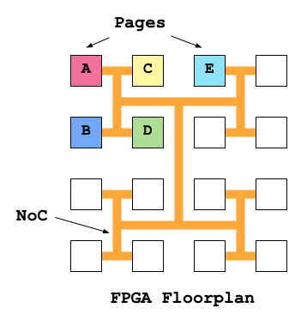

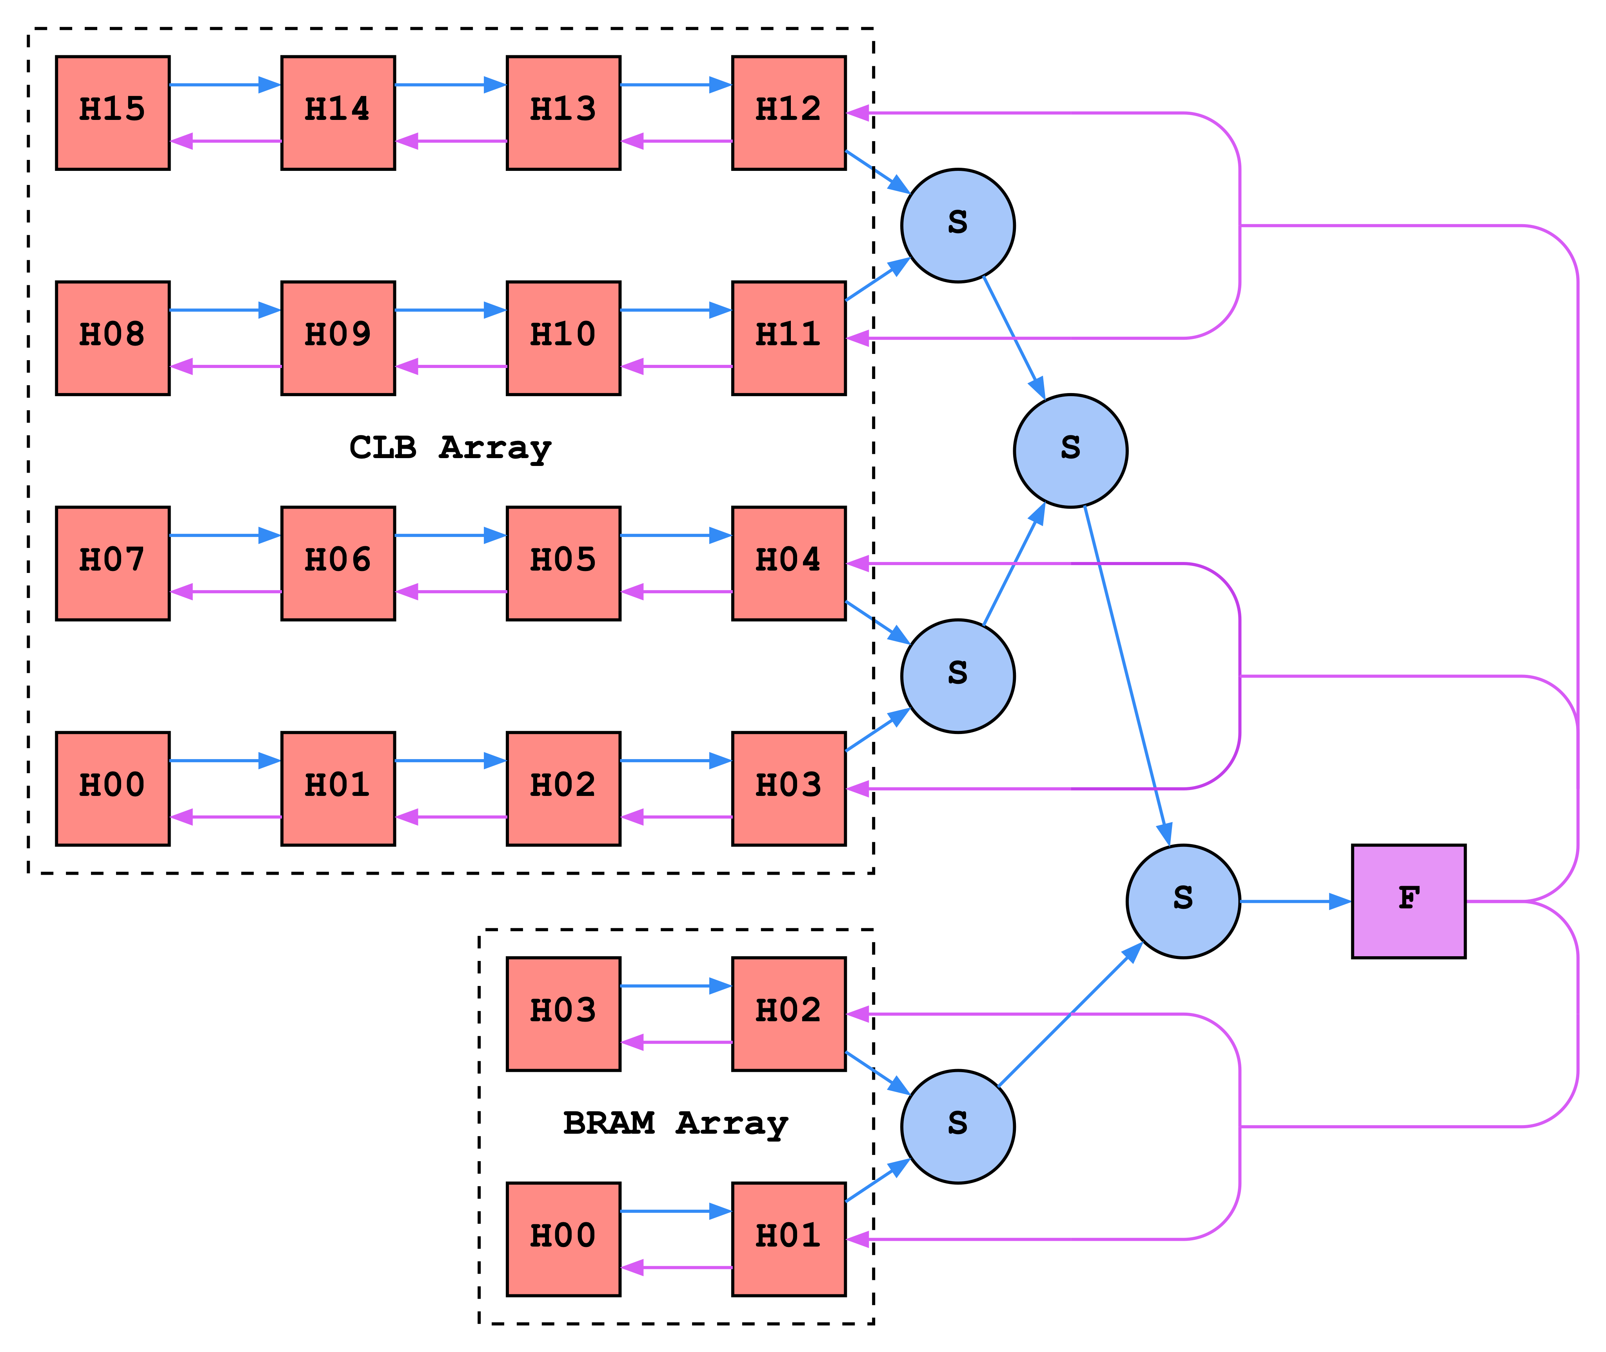
Our Accelerator: Strategy
Targeting PR-Flow pages instead of full device makes build-to-place ratio less consequential
Placing clusters of LUTs (CLBs) reduces build-to-place ratio
Creating separate systolic arrays for CLBs, BRAMs, and DSPs enables heterogeneous targets
Notes:
Our strategy centered around three key insights:
First, by targeting PR-Flow pages instead of full devices, the poor build-to-place ratio of the systolic architecture becomes less consequential since the target is smaller [click]
Second, by having individual PEs place clusters of LUTs instead of individual LUTs, we can reduce the build-to-place ratio by the packing factor of a CLB [click]
Third, by creating separate systolic arrays for CLBs, BRAMs, and DSPs, we can target heterogeneous fabrics

Slide 17
Our Accelerator: Challenges
PE swap times scale poorly with the number of connections, and CLBs, BRAMs and DSPs have lots of connections
We must eliminate iteration over connection coordinates
Requires reiteration!
Post-swap cost
Pre-swap cost
Notes:
There is, however, one challenge in particular which stands in the way:
The PE swap times scale poorly with the number of connections a cell can have, and CLBs, BRAMs, and DSPs have many more connections than individual LUTs.
The scaling is poor because the placement cost for a cell is calculated by iterating over all of that cell’s connections, and computing their distance to our cell’s current position. Because of how x is coupled to p sub i in the equation, every time the cell’s position changes, the list of connections must be iterated over again, in order to re-evaluate the cell’s current placement cost.
[click]
This is the swap decision function which determines the cost change of a swap. Again, note that the x-values are stuck inside the sums, requiring reiteration over the connection lists every time the cells change positions.
This repeated iteration during every swap evaluation quickly becomes the compute bottleneck as the number of connections grows. Additionally, during a swap, the pair of PEs must exchange their lists of connections, which also becomes expensive as the number of connections grows.

Slide 18
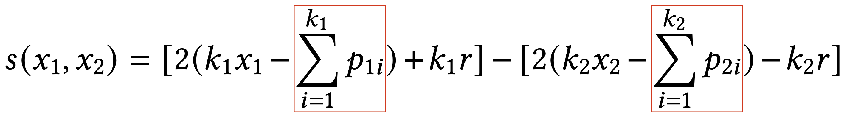
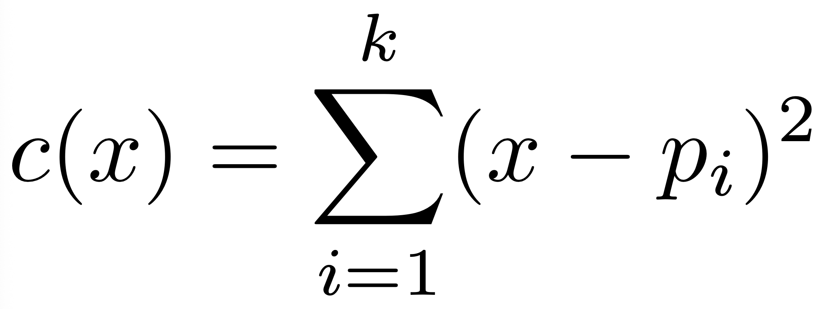
Our Accelerator: Solution
Use quadratic wirelength as new local cost function
  Refactor equation to isolate connection coordinate sums from x
Results
  Aggregate sums of connection coords used for swaps, not discrete lists
  No more connection list iteration!
  No more connection list transfers!
  See paper for details
Constant!
Constant!
Notes:
We address this by using quadratic wire length instead of Manhattan wire length for our cost function. Doing so allows us to refactor the swap evaluation function so that the sums of the cells’ connection coordinates becomes decoupled from the x-coordinates encoding the pair’s position.
[click]
As you can see, in this resultant swap evaluation function, the x-values are decoupled from the sums.
[click]
This means that these sums become constants that can be pre-computed once, eliminating the need for endless iteration over the lists of connections.
Furthermore, since swap decisions are now only based on these precomputed sums, the long lists of cell connections do not need to be exchanged during swaps; only the precomputed aggregate sums must be exchanged.
The details of this are subtle, so please see the paper for details.

Slide 19
Our Accelerator: Additional Details
We use separate systolic arrays for each cell type
Global synchronization requires updating local cost functions with new cell positions.
Update requires recomputing connection coordinate sums through a sum-reduce tree
Notes:
In order to support the placement of heterogeneous netlists, we create separate arrays for each cell type, (for example, one here for CLBs, and another for BRAMs). [click]
As swaps are performed in parallel, the information each cell has about its neighbors’ positions becomes stale, and must be periodically updated through a complex global synchronization process. [click]
In essence, this update process requires recomputing the connection coordinate sums through the use of a sum-reduce tree. See the paper for details.

Slide 20

Implementation
RTL Generator
  Input: Target VTR architecture description
  Output: Systolic Accelerator RTL
Versal VCK190 SoC
  200 MHz
  Versal resources: 714K LUTs, 975 BRAMs, 967 DSPs
  VTR target page: 910 CLBs, 25 BRAMs, 32 DSPs
  LUT build to place ratio: 72 : 1
Behavioral and RTL Simulators
  Large target page: 7500 CLBs, 208 BRAMs, 300 DSPs
(Image from amd.com)
Notes:
To implement our accelerator, we created an RTL generator which takes as input a target VTR architecture description, and outputs the RTL for our systolic array accelerator. [click]
We then implemented our accelerator on a Versal VCK190 SoC dev kit, clocking the design at 200 MHz. We targeted a VTR architecture with 10 LUTs per CLB that had BRAMs and DSPs, and the resultant build-to-place ratio worked out to 72 : 1 [click]
Finally, we also created simulators for a much larger target VTR page, which you can see here.

Slide 21
Table of Contents
Motivation
Background
Our Accelerator
Evaluation
Conclusion
Notes:
Evaluation

Slide 22
Benchmarks
Rosetta benchmarks
  Dataflow Application Pages
  Run on Versal
VTR benchmarks
  Generic VTR applications
  Run on Versal
Misc. benchmarks
  Larger VTR benchmarks and small systolic placer
  Run in Simulation
 |  | Benchmarks | CLBs | BRAMs | DSPs | IOs
Versal | Rosetta | update_knn1 | 747 | 23 | 0 | 96
 |  | update_knn2 | 609 | 23 | 0 | 96
 |  | data_1_4_2 | 319 | 13 | 0 | 96
 |  | dotProduct_1 | 330 | 13 | 3 | 96
 |  | rasterization2_m | 379 | 16 | 3 | 96
 |  | zculling_bot | 241 | 18 | 0 | 96
 | VTR | arm_core | 866 | 24 | 0 | 312
 |  | bgm | 289 | 0 | 0 | 289
 |  | blob_merge | 572 | 0 | 0 | 136
 |  | mkSMAdapter4B | 157 | 5 | 0 | 398
 |  | or1200 | 246 | 2 | 1 | 779
 |  | raygentop | 119 | 1 | 6 | 540
 |  | sha | 151 | 0 | 0 | 74
 |  | stereovision0 | 768 | 0 | 0 | 366
Sim. | Misc. | LU32PEEng | 4443 | 168 | 32 | 216
 |  | mcml | 4772 | 159 | 27 | 392
 |  | stereovision2 | 2059 | 0 | 179 | 331
 |  | hetero_placer | 4926 | 76 | 74 | 40
Notes:
We evaluated our placement accelerator on three sets of benchmarks:
The first were data-flow designs from the Rosetta benchmark suite which had been broken up into PR-Flow style pages. We placed these benchmarks using our accelerator implemented on the Versal [click]
The second set were VTR benchmarks which we also placed using the Versal [click]
The third set were composed of much larger VTR benchmarks, as well as the netlist of our own systolic accelerator (hetero_placer). This last set was run in simulation.

Slide 23
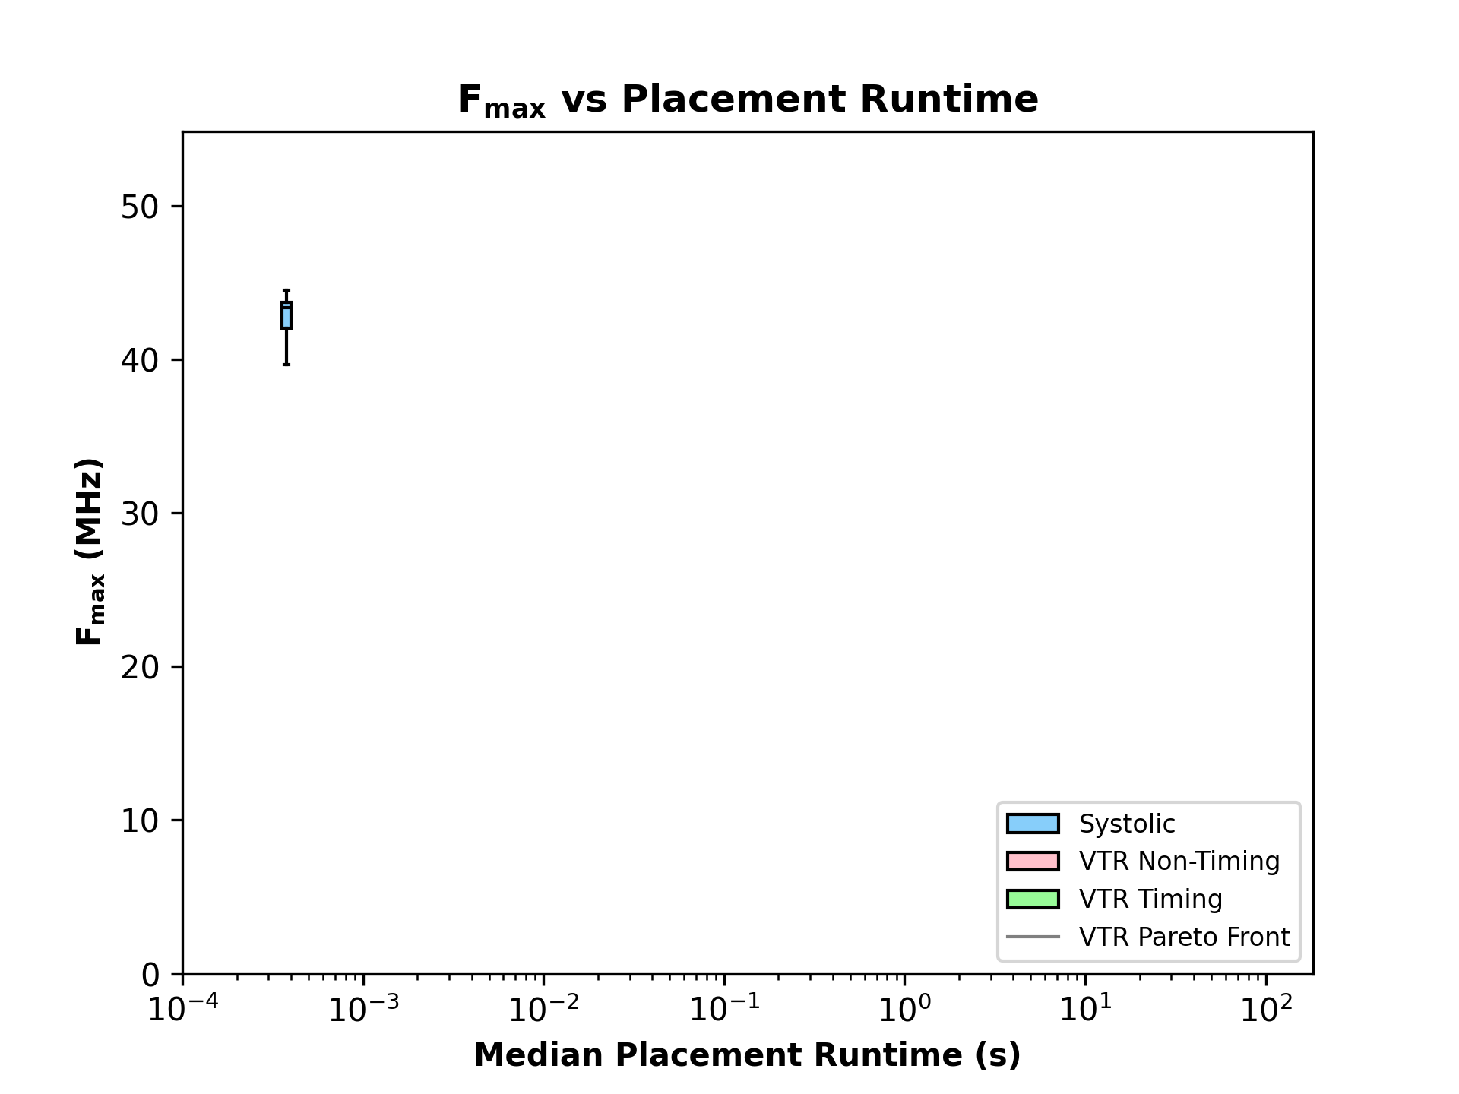
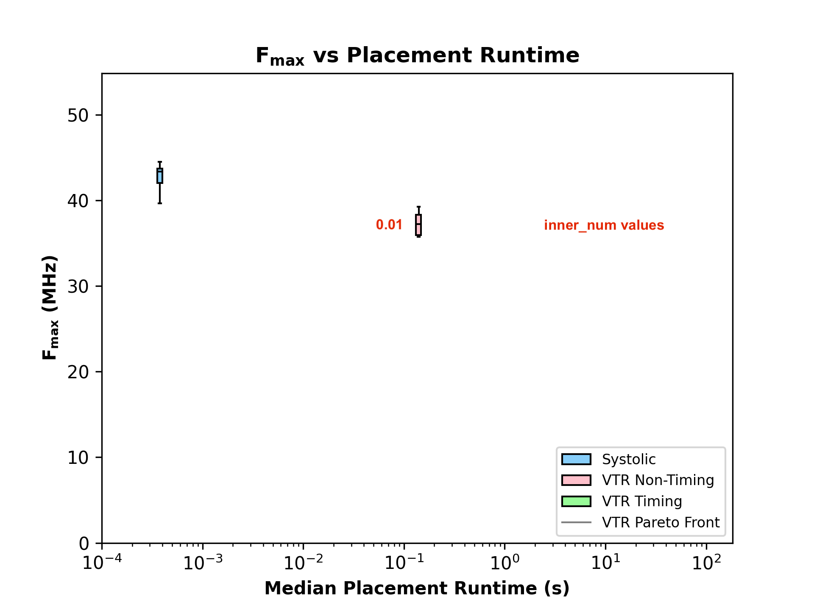
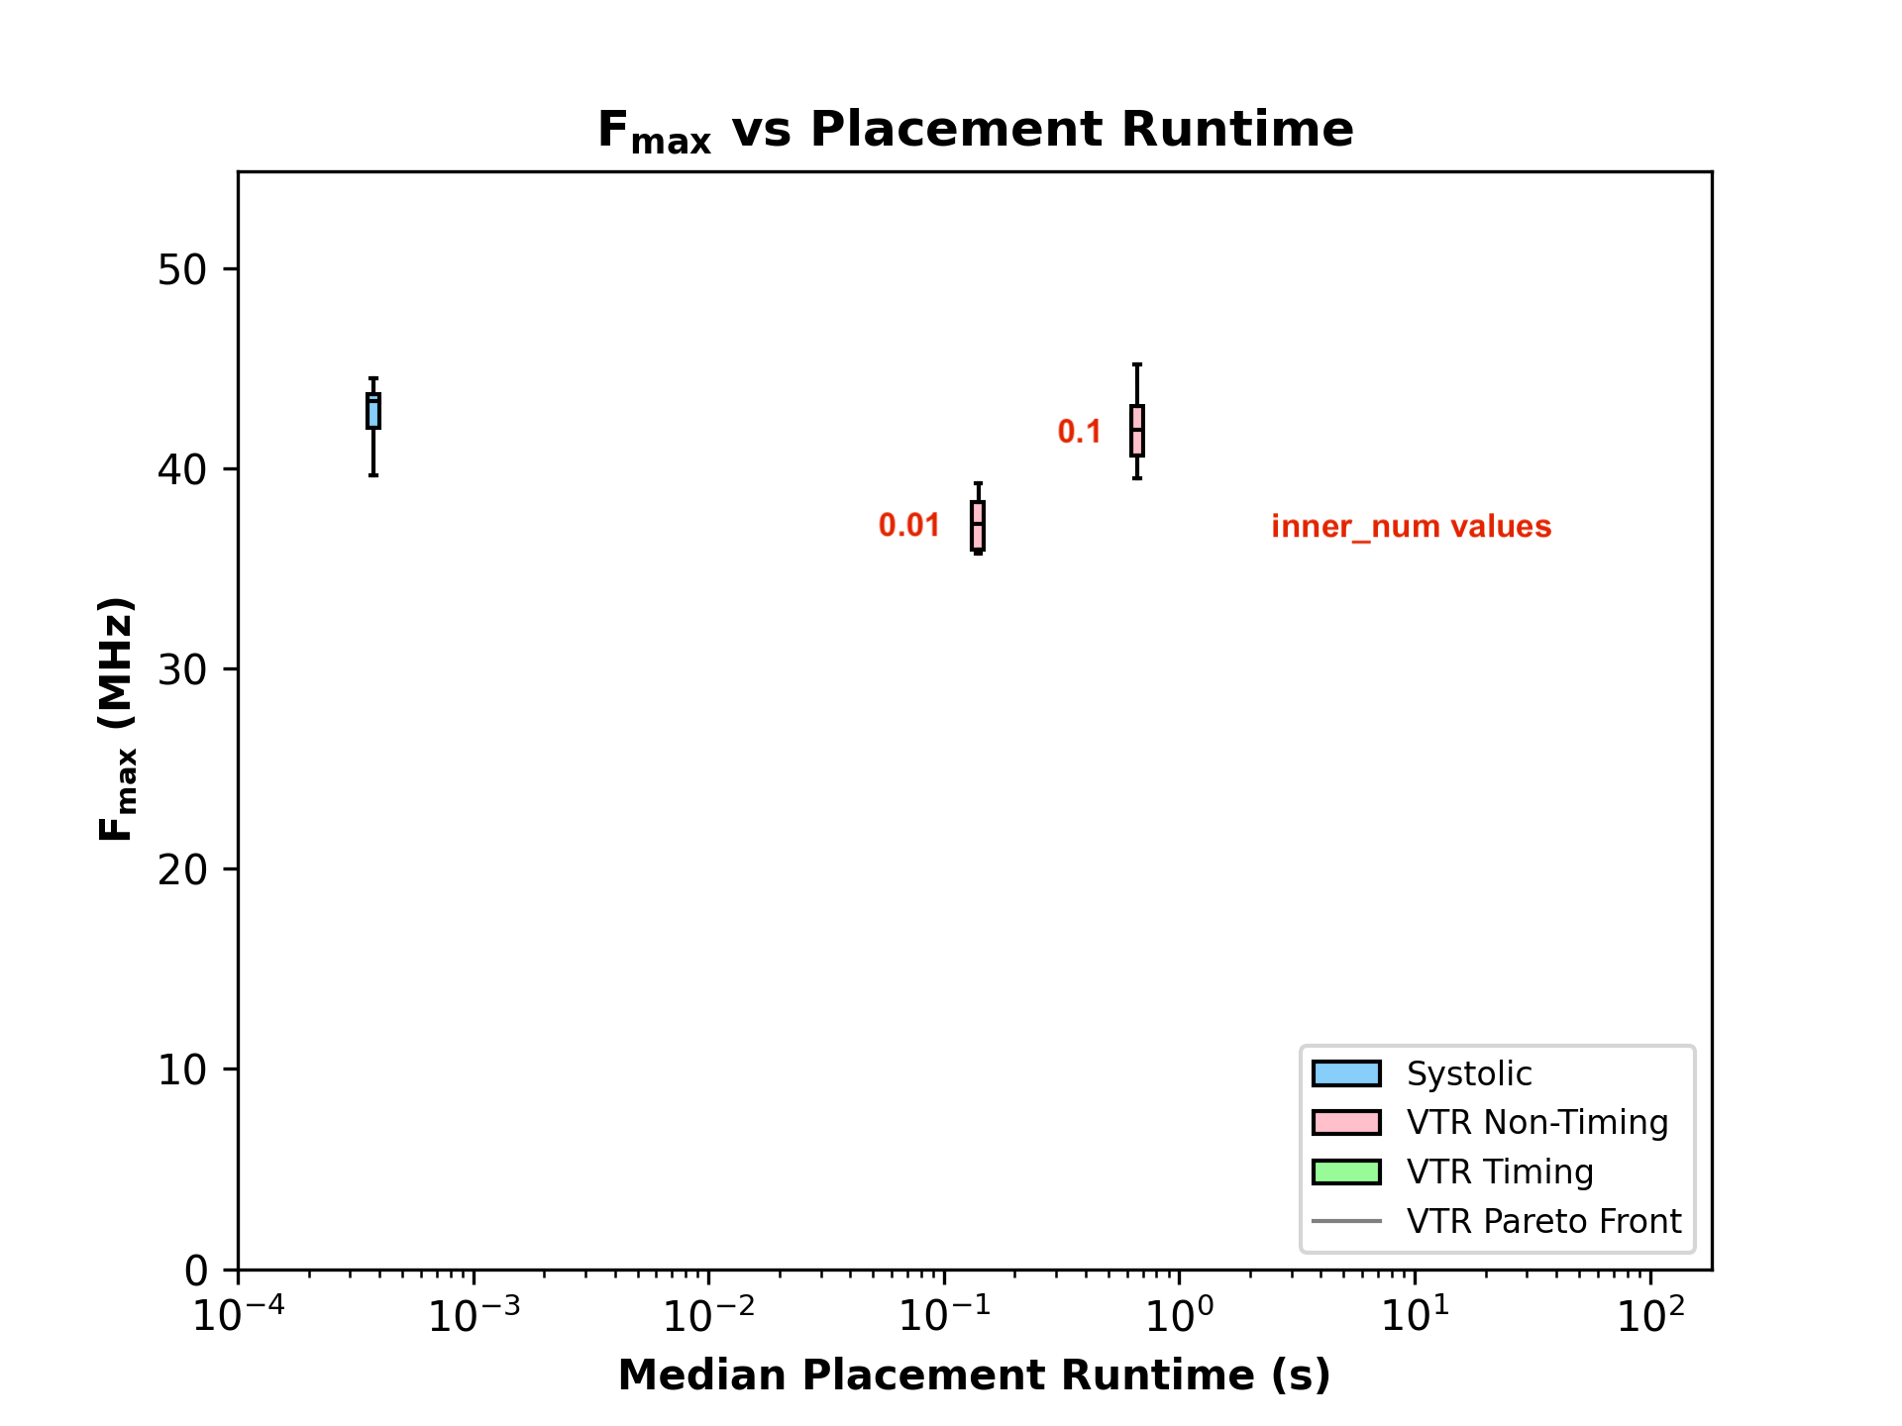
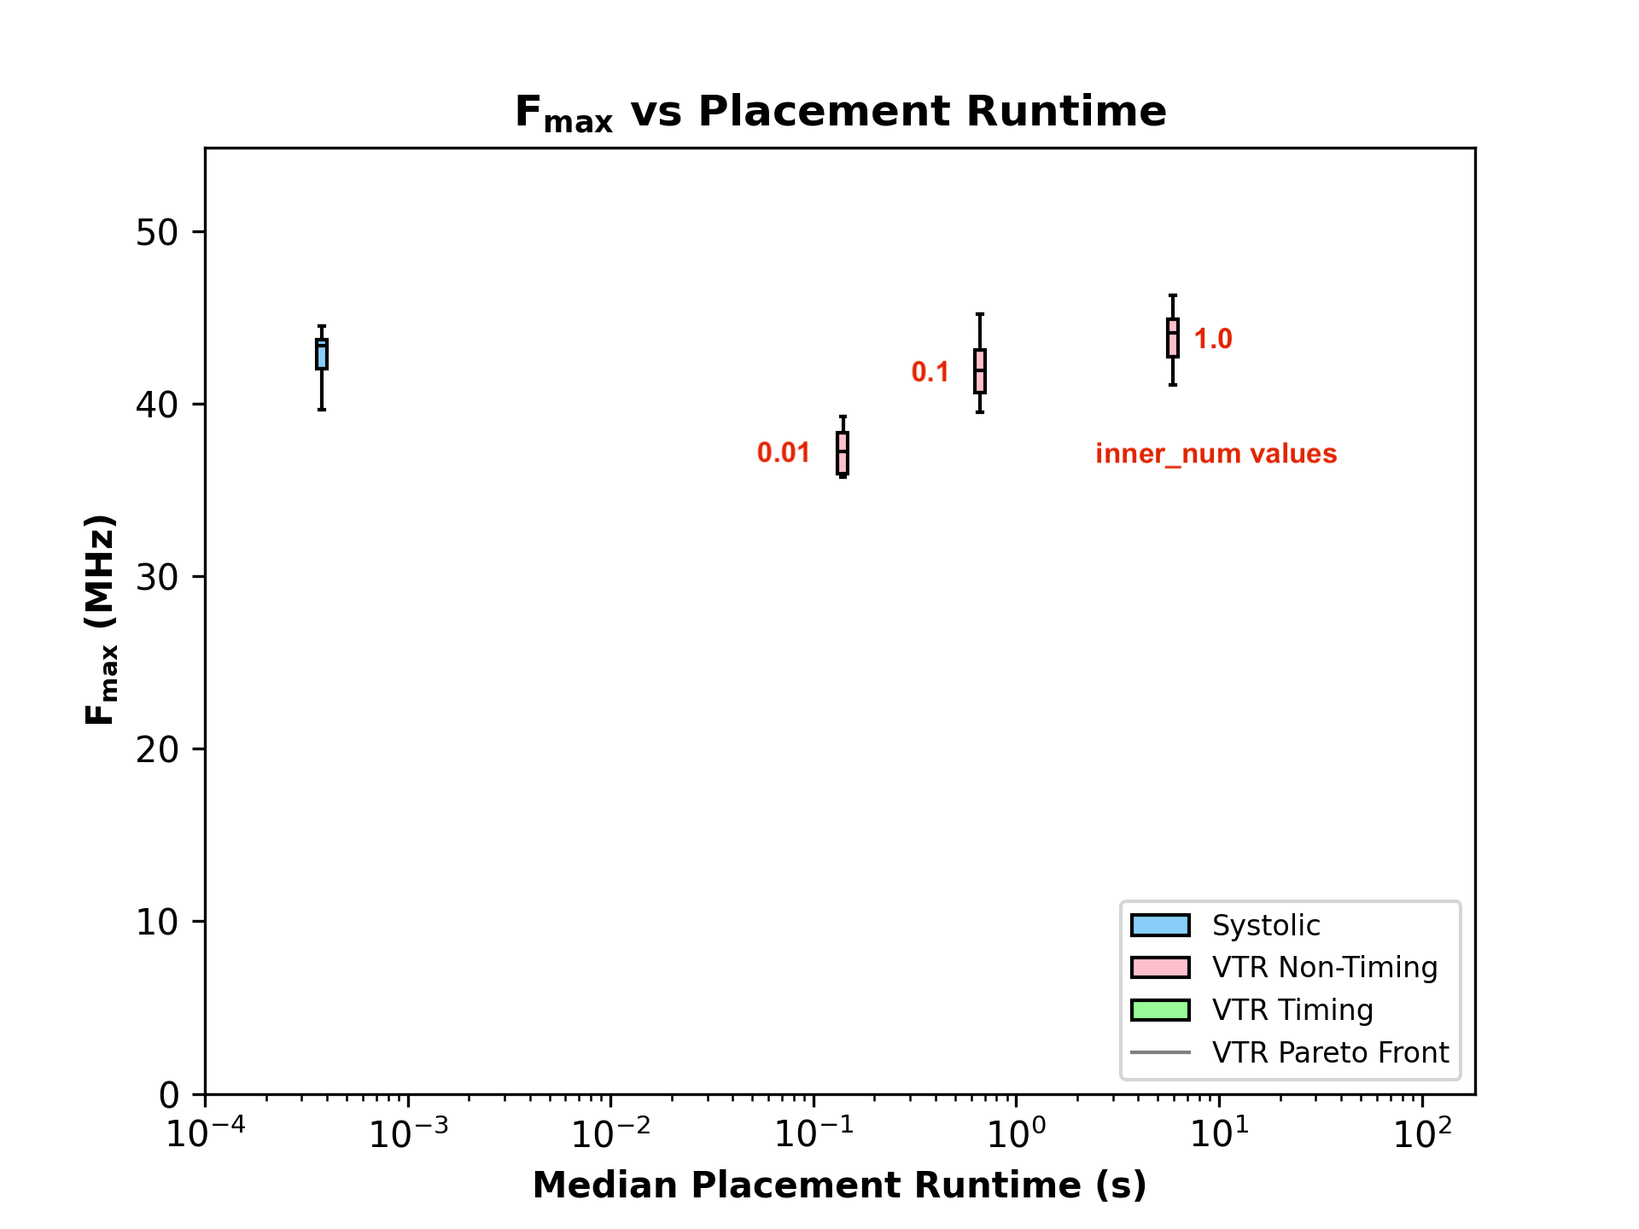
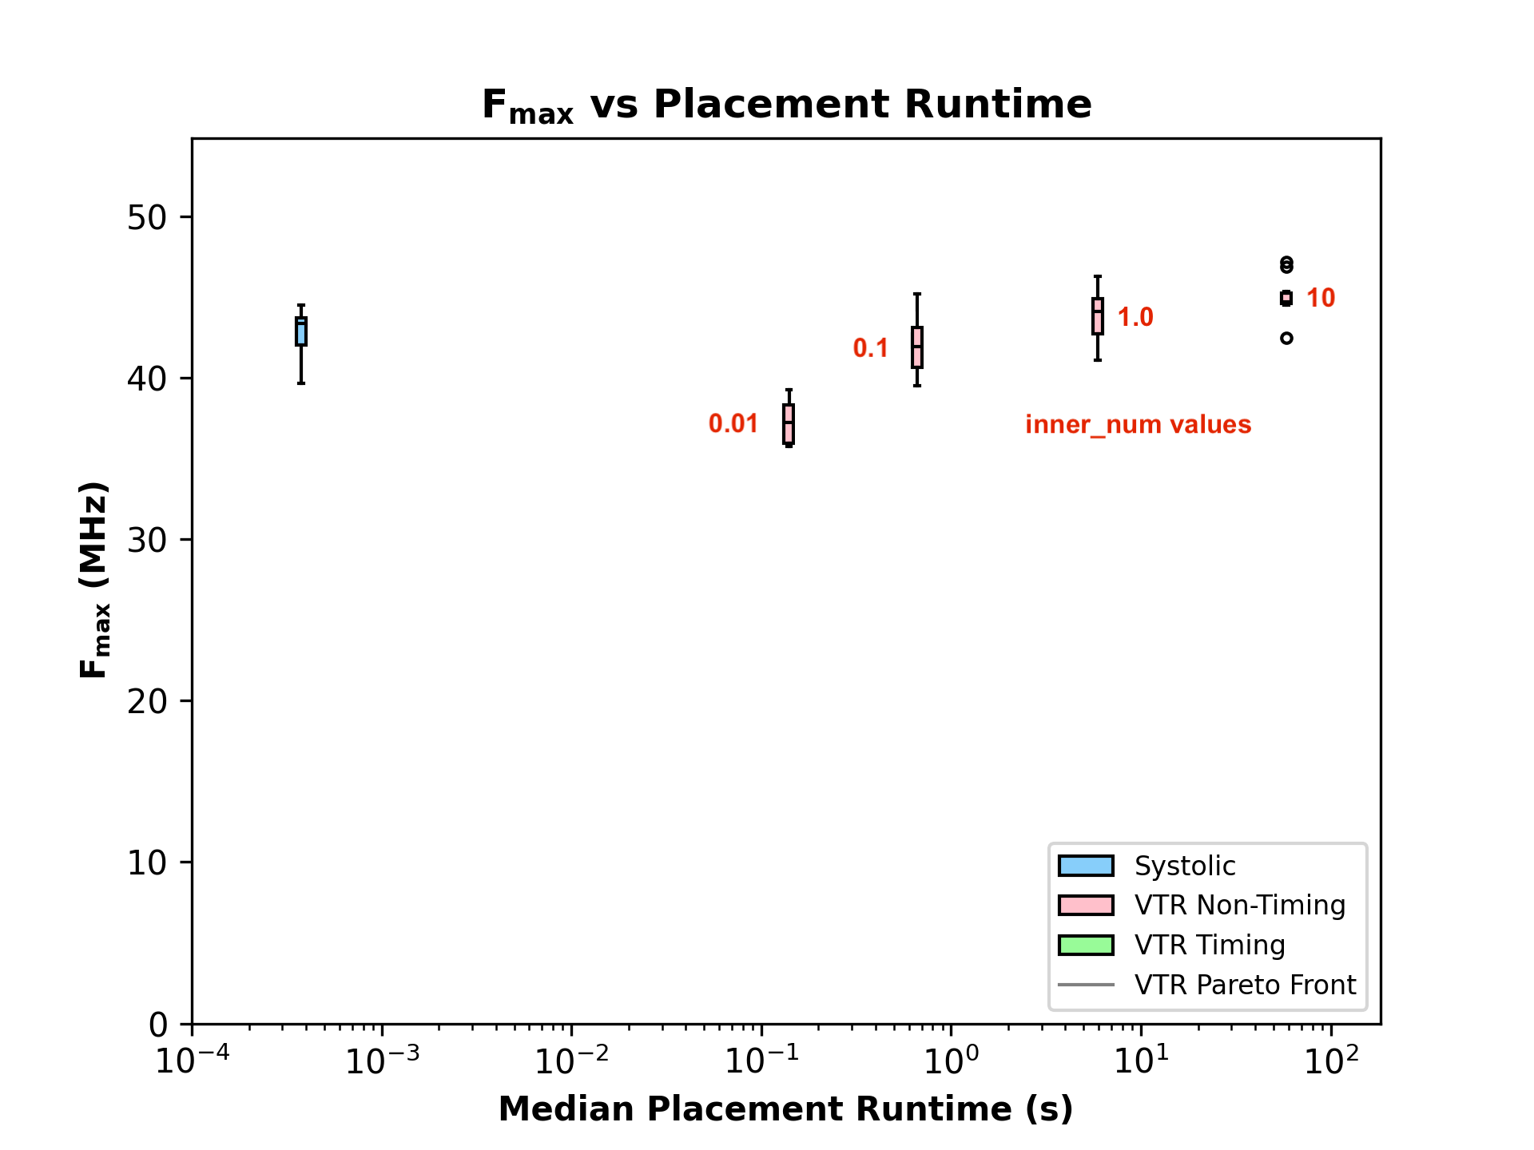
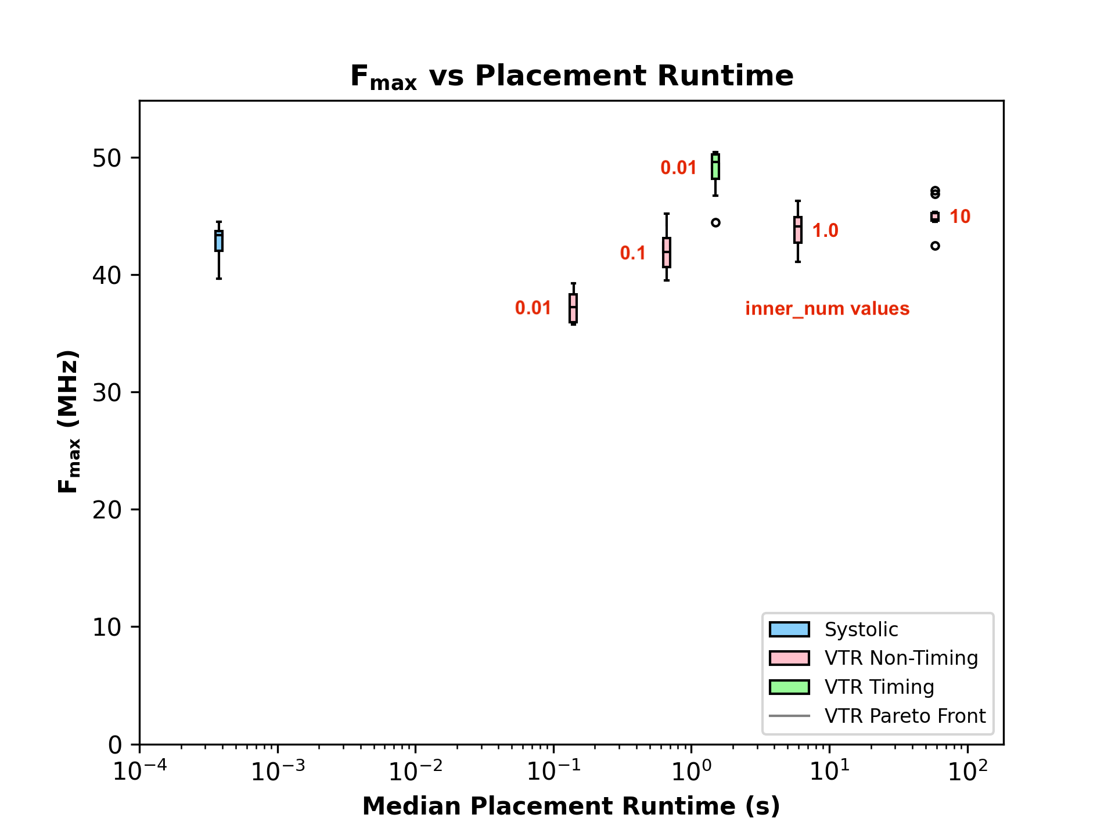
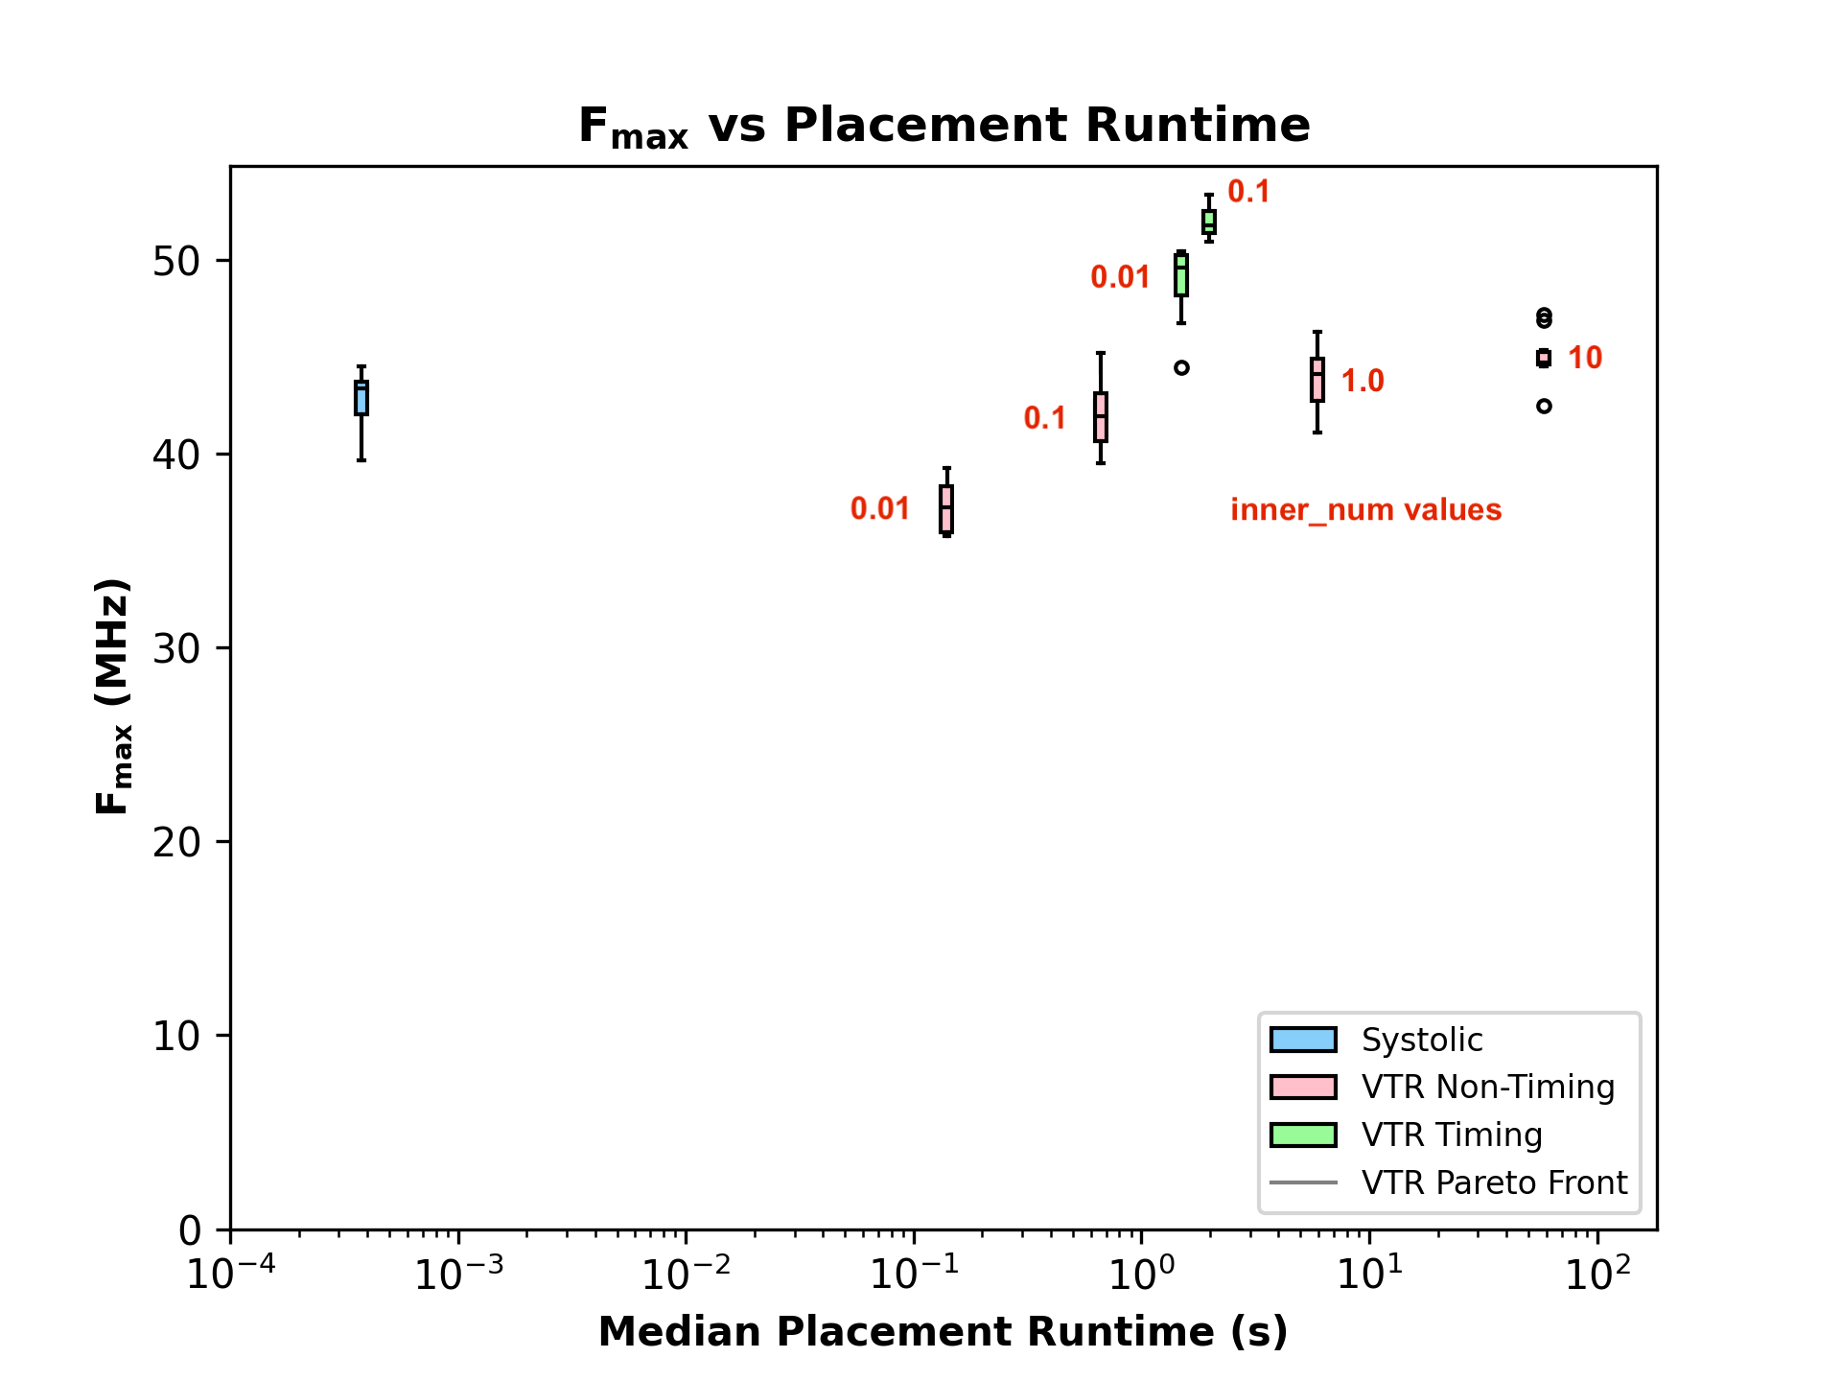
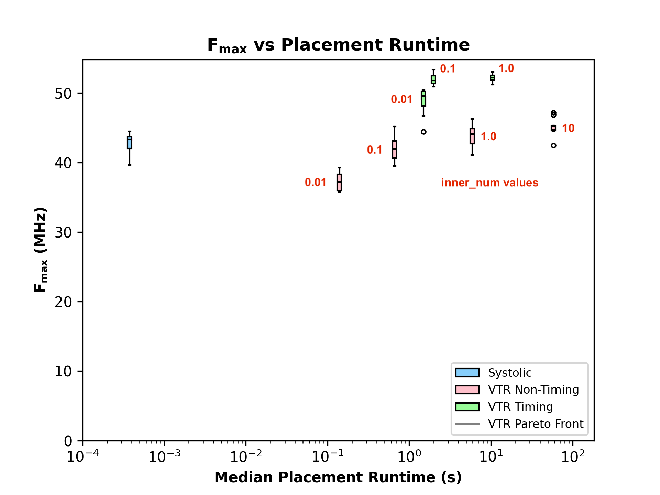
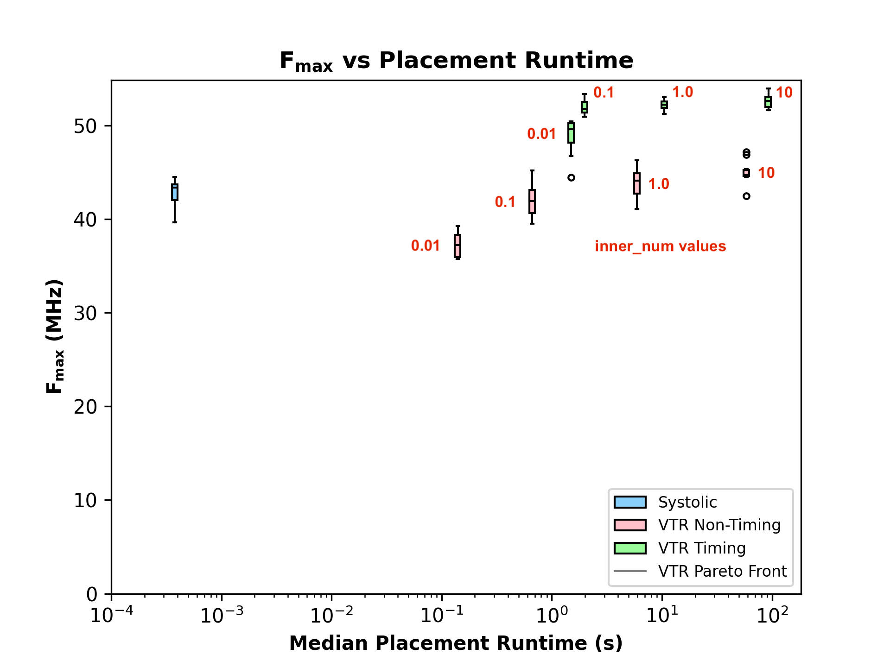
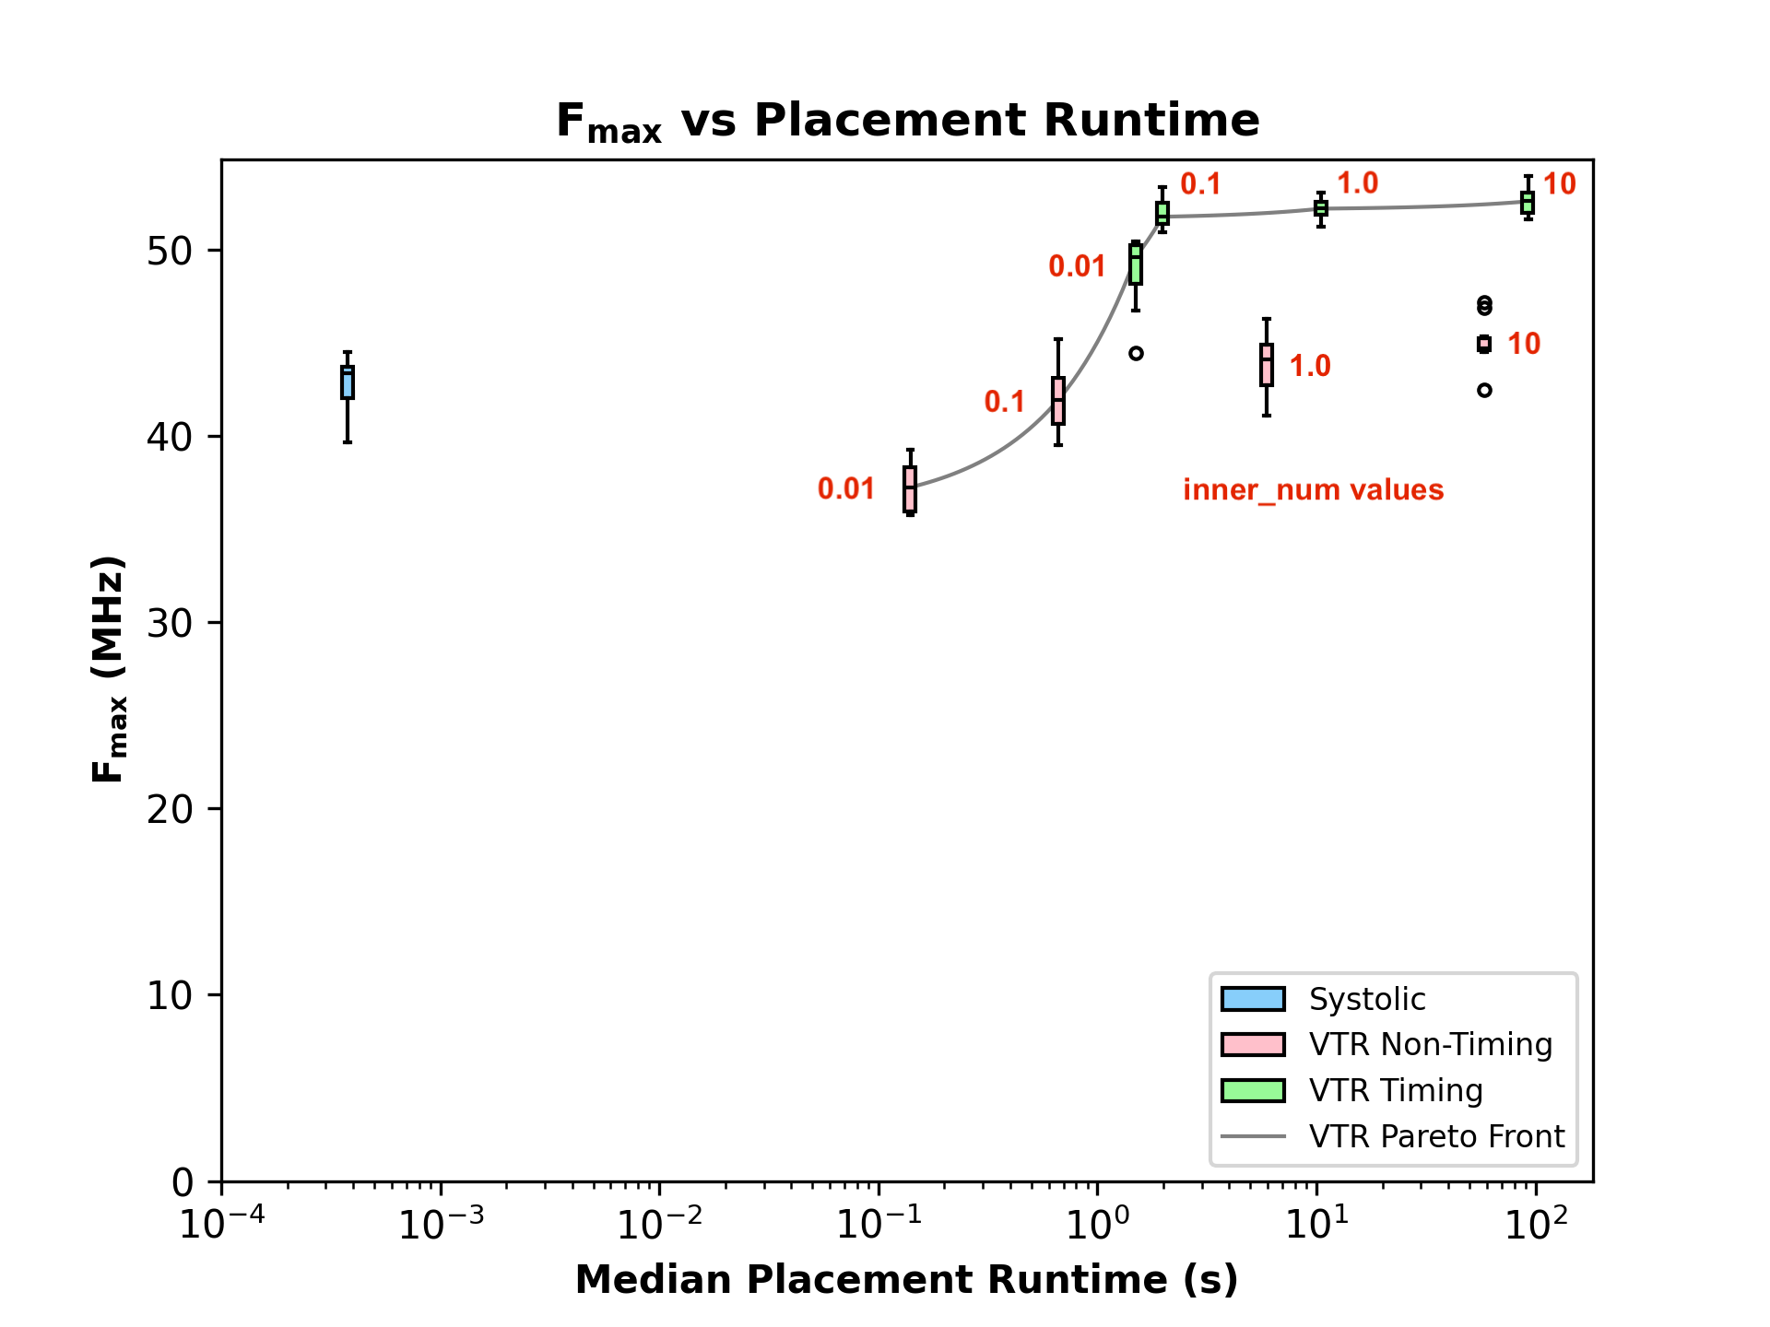
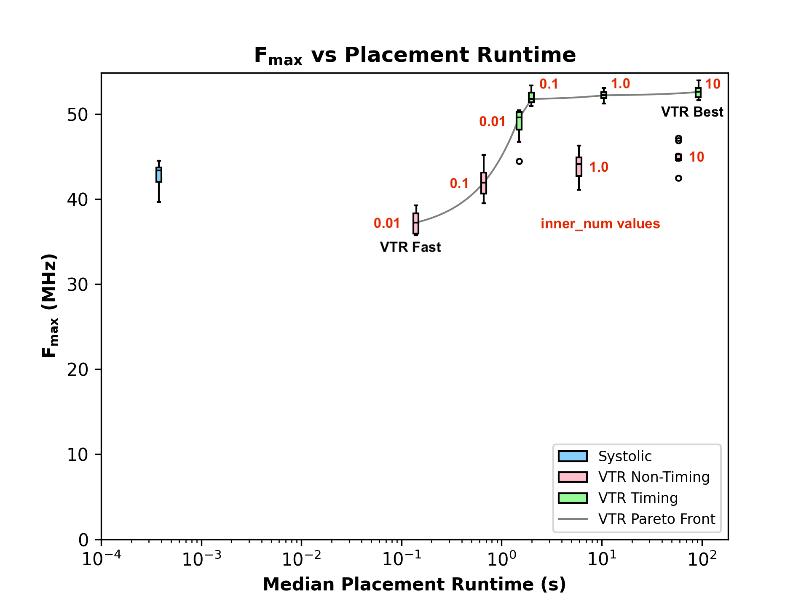
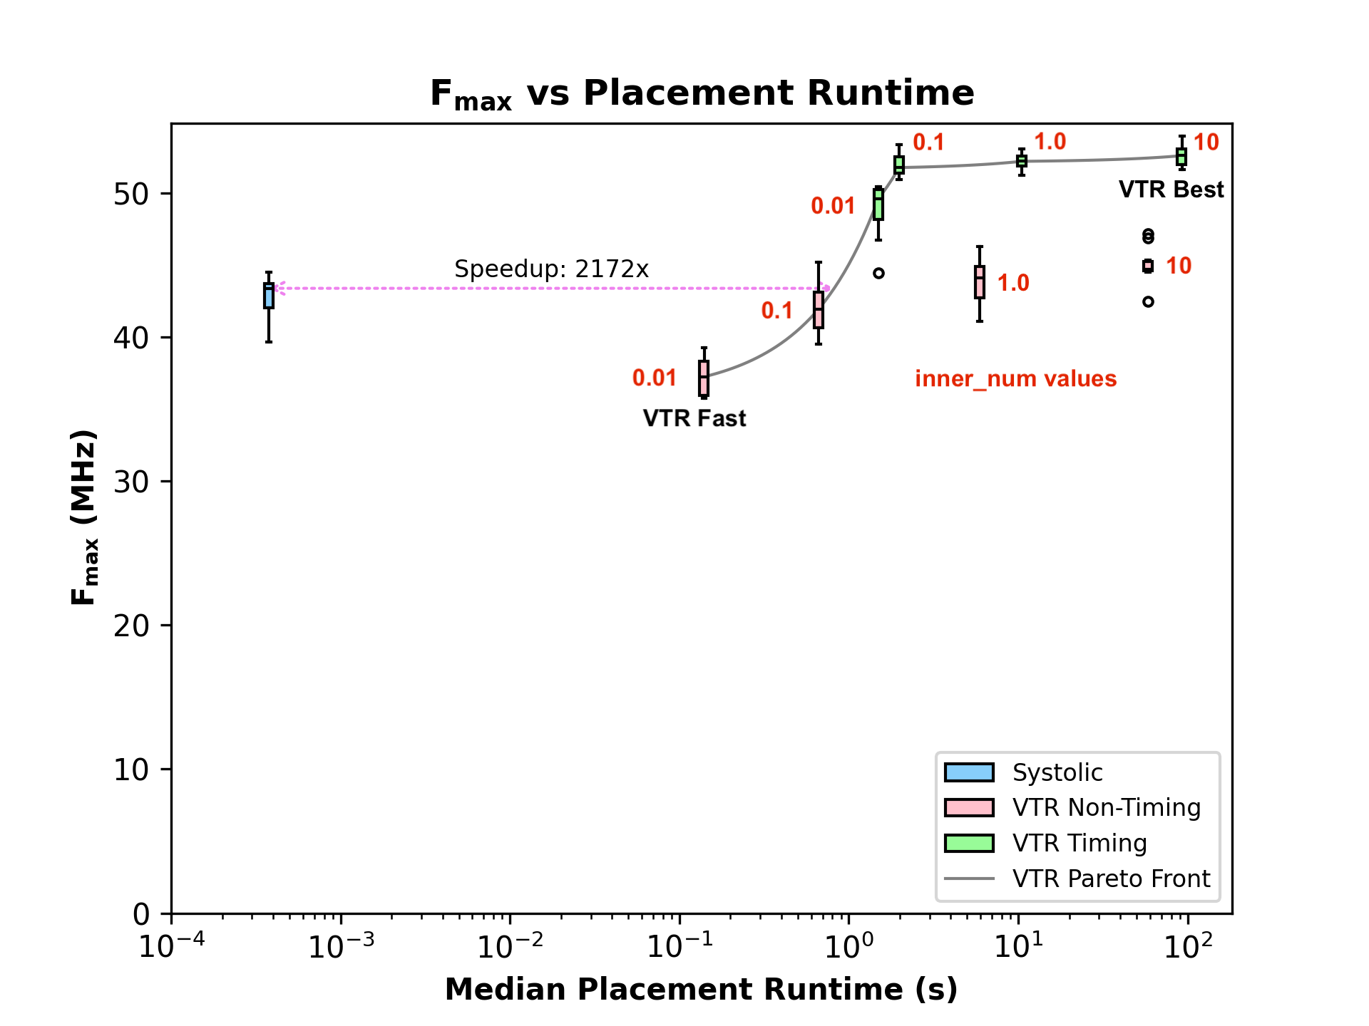
Systolic to VTR Comparison
VTR-9 on CPU
  AMD Ryzen 9 5900X
  3.9 GHz
  12 threads
  Explore time/quality points by sweeping parameters
Systolic Placer
  200 MHz
  10 sets of swaps per update
  25 updates
Speedup: 2172x
Notes:
We compared our systolic accelerator to VTR-9 running on an AMD Ryzen 9 running at 3.9 GHz, with 12 threads. We performed placement with VTR in both timing and non-timing driven modes, and also swept the inner_num parameter which trades off quality for runtime. We ran 10 trials for each design point.
We then performed low-stress routes on the placements, and plotted the maximum frequency of the compiled design against the log of the placement runtime.
Here you can see the systolic time-quality point when placing the arm_core benchmark.
And here you can see VTR’s non-timing driven time-quality points as we sweep the inner_num parameter.
And here you can see VTR’s timing driven time-quality points.
Then we linearly interpolate between points to show the pareto time-quality tradeoff front.
Next we label both the fastest and the best quality VTR points, showing VTR’s time-quality range.
Finally, we project from the systolic point onto the pareto front, to show the systolic iso-quality speedup over VTR

Slide 24
Systolic Speedup and Relative Quality
Results Table:
  Systolic speedup vs VTR
  Systolic Fmax achieved vs VTR
Systolic Runtimes:
  0.4 ms (Versal)
  4.9 ms (Large Simulation)
VTR Runtimes:
  See paper
 |  |  | vs. VTR Fast |  | Iso-Quality | vs. VTR Best
 |  | Benchmark | Systolic Speedup | Relative Quality | Systolic Speedup | Systolic Speedup
Versal | Rosetta | update_knn1 | 212 | 1.26 | 1460 | 13426
 |  | update_knn2 | 185 | 1.14 | 657 | 11519
 |  | data_1_4_2 | 79 | 1.15 | 392 | 47123
 |  | dotProduct_1 | 79 | 1.06 | 287 | 5601
 |  | rasterization_m | 106 | 1.06 | 370 | 6514
 |  | zculling_bot | 79 | 1.05 | 315 | 39086
 | VTR | arm_core | 371 | 1.16 | 2172 | 245045
 |  | bgm | 106 | 1.00 | 175 | 7918
 |  | blob_merge | 159 | 1.20 | 1612 | 97478
 |  | mkSMAdapter4B | 79 | 0.96 | 79 | 4833
 |  | or1200 | 199 | 1.02 | 411 | 165548
 |  | raygentop | 79 | 0.96 | 79 | 70467
 |  | sha | 26 | 1.07 | 144 | 2304
 |  | stereovision0 | 238 | 1.01 | 318 | 137358
 |  |  | Geomean 118 | Median 1.06 | Geomean 370 | Geomean 24892
Sim. | Misc. | LU32PEEng | 209 | 0.90 | 209 | 175429
 |  | mcml | 177 | 1.17 | 827 | 131234
 |  | stereovision2 | 79 | 1.17 | 541 | 5965
 |  | hetero_placer | 1208 | 1.05 | 1479 | 163320
 |  |  | Geomean 244 | Median 1.11 | Geomean 610 | Geomean 68817
 |  |  | vs. VTR Fast |  | Iso-Quality | vs. VTR Best
 |  | Benchmark | Systolic Speedup | Relative Quality | Systolic Speedup | Systolic Speedup | Relative Quality
Versal | Rosetta | update_knn1 | 212 | 1.26 | 1460 | 13426 | 0.83
 |  | update_knn2 | 185 | 1.14 | 657 | 11519 | 0.81
 |  | data_1_4_2 | 79 | 1.15 | 392 | 47123 | 0.89
 |  | dotProduct_1 | 79 | 1.06 | 287 | 5601 | 0.95
 |  | rasterization_m | 106 | 1.06 | 370 | 6514 | 0.96
 |  | zculling_bot | 79 | 1.05 | 315 | 39086 | 0.91
 | VTR | arm_core | 371 | 1.16 | 2172 | 245045 | 0.82
 |  | bgm | 106 | 1.00 | 175 | 7918 | 0.97
 |  | blob_merge | 159 | 1.20 | 1612 | 97478 | 0.88
 |  | mkSMAdapter4B | 79 | 0.96 | 79 | 4833 | 0.90
 |  | or1200 | 199 | 1.02 | 411 | 165548 | 0.92
 |  | raygentop | 79 | 0.96 | 79 | 70467 | 0.89
 |  | sha | 26 | 1.07 | 144 | 2304 | 0.92
 |  | stereovision0 | 238 | 1.01 | 318 | 137358 | 0.81
 |  |  | Geomean 118 | Median 1.06 | Geomean 370 | Geomean 24892 | Median 0.90
Sim. | Misc. | LU32PEEng | 209 | 0.90 | 209 | 175429 | 0.71
 |  | mcml | 177 | 1.17 | 827 | 131234 | 0.91
 |  | stereovision2 | 79 | 1.17 | 541 | 5965 | 0.84
 |  | hetero_placer | 1208 | 1.05 | 1479 | 163320 | 0.76
 |  |  | Geomean 244 | Median 1.11 | Geomean 610 | Geomean 68817 | Median 0.80
 |  |  | vs. VTR Fast |  | Iso-Quality | vs. VTR Best
 |  | Benchmark | Systolic Speedup | Relative Quality | Systolic Speedup
Versal | Rosetta | update_knn1 | 212 | 1.26 | 1460
 |  | update_knn2 | 185 | 1.14 | 657
 |  | data_1_4_2 | 79 | 1.15 | 392
 |  | dotProduct_1 | 79 | 1.06 | 287
 |  | rasterization_m | 106 | 1.06 | 370
 |  | zculling_bot | 79 | 1.05 | 315
 | VTR | arm_core | 371 | 1.16 | 2172
 |  | bgm | 106 | 1.00 | 175
 |  | blob_merge | 159 | 1.20 | 1612
 |  | mkSMAdapter4B | 79 | 0.96 | 79
 |  | or1200 | 199 | 1.02 | 411
 |  | raygentop | 79 | 0.96 | 79
 |  | sha | 26 | 1.07 | 144
 |  | stereovision0 | 238 | 1.01 | 318
 |  |  | Geomean 118 | Median 1.06 | Geomean 370
Sim. | Misc. | LU32PEEng | 209 | 0.90 | 209
 |  | mcml | 177 | 1.17 | 827
 |  | stereovision2 | 79 | 1.17 | 541
 |  | hetero_placer | 1208 | 1.05 | 1479
 |  |  | Geomean 244 | Median 1.11 | Geomean 610
 |  |  | vs. VTR Fast |  | Iso-Quality | vs. VTR Best
 |  | Benchmark |  |  | Systolic Speedup
Versal | Rosetta | update_knn1 |  |  | 1460
 |  | update_knn2 |  |  | 657
 |  | data_1_4_2 |  |  | 392
 |  | dotProduct_1 |  |  | 287
 |  | rasterization_m |  |  | 370
 |  | zculling_bot |  |  | 315
 | VTR | arm_core |  |  | 2172
 |  | bgm |  |  | 175
 |  | blob_merge |  |  | 1612
 |  | mkSMAdapter4B |  |  | 79
 |  | or1200 |  |  | 411
 |  | raygentop |  |  | 79
 |  | sha |  |  | 144
 |  | stereovision0 |  |  | 318
 |  |  |  |  | Geomean 370
Sim. | Misc. | LU32PEEng |  |  | 209
 |  | mcml |  |  | 827
 |  | stereovision2 |  |  | 541
 |  | hetero_placer |  |  | 1479
 |  |  |  |  | Geomean 610
 |  |  | vs. VTR Fast |  | Iso-Quality | vs. VTR Best
 |  | Benchmark | Systolic Speedup |  | Systolic Speedup
Versal | Rosetta | update_knn1 | 212 |  | 1460
 |  | update_knn2 | 185 |  | 657
 |  | data_1_4_2 | 79 |  | 392
 |  | dotProduct_1 | 79 |  | 287
 |  | rasterization_m | 106 |  | 370
 |  | zculling_bot | 79 |  | 315
 | VTR | arm_core | 371 |  | 2172
 |  | bgm | 106 |  | 175
 |  | blob_merge | 159 |  | 1612
 |  | mkSMAdapter4B | 79 |  | 79
 |  | or1200 | 199 |  | 411
 |  | raygentop | 79 |  | 79
 |  | sha | 26 |  | 144
 |  | stereovision0 | 238 |  | 318
 |  |  | Geomean 118 |  | Geomean 370
Sim. | Misc. | LU32PEEng | 209 |  | 209
 |  | mcml | 177 |  | 827
 |  | stereovision2 | 79 |  | 541
 |  | hetero_placer | 1208 |  | 1479
 |  |  | Geomean 244 |  | Geomean 610
Notes:
This table summarizes the systolic speedup compared to VTR as well as its relative quality: the ratio of systolic Fmax to VTR Fmax
First we look here at the iso-quality speedup, which we calculated on the previous slide with the projection onto the Pareto front. We see in the green that the systolic placer runs an average of 370 times faster than VTR.
Then we look at the systolic speedup vs the fastest VTR can run at [click] and we see that on average it runs 118 times faster than VTR, [click] and here that its quality is 6% better than VTR.
[click] Finally we look at the speedup vs the best quality but slowest VTR point and see that it runs nearly 25,000 times faster than VTR [click], but we see that this comes at a 10% loss in quality
We also have the results for the larger benchmarks run in simulation [click]
[talk about runtimes]

Slide 25
Table of Contents
Motivation
Background
Our Accelerator
Evaluation
Conclusion
Notes:
Conclusion

Slide 26
Conclusion
FPGA compilation is excruciatingly slow (up to hours long runtime)
  Limits developer productivity
  Prevents use in real-time reconfiguration applications like online-tuning and self-healing
  Placement and routing most expensive phases of compilation
Separate page-based compilation achieves acceleration through
divide-and-conquer (e.g. PR-Flow)
  Accelerates compilation by a factor of the number of pages
  Brings compile times down to 10s of seconds to minutes (but too slow for real-time applications)
Using FPGAs themselves to perform page compilation enables significant acceleration
  We present an FPGA based systolic array which solves FPGA page placement in milliseconds
  Eliminated swap time scaling with the number of cell connections
  Reduced build-to-place ratio from 400:1 down to 72:1
  Targets heterogeneous VTR-9 device models with CLBs, BRAMs, and DSPs
  Achieves 2-3 orders of magnitude speedup over iso-quality VTR-9 results
Notes:
In conclusion, FPGA compilation is excruciatingly slow, and while page-based parallel compilation can significantly reduce the runtimes, it is still too slow for applications requiring real-time reconfiguration. [click]
Using FPGAs themselves to perform compilation can enable significant acceleration. We present an FPGA based systolic array which solves FPGA page placement in milliseconds. [click]
We eliminated swap-time scaling with the number of connections a cell has.
We reduced the build-to-place ratio of prior work from 400:1 down to 72:1 by placing CLBs instead of LUTs
We extended targets to heterogeneous VTR-9 device models with CLBs, BRAMs, and DSPs.
And finally, we attained 2-3 orders of magnitude speedup of iso-quality VTR-9 results
Thank you.

